Slide 1
2019
Isla Earth: What Islands Can Teach The World About Sustainability
Lorraine H. Akiba
President/CEO
LHA Ventures

Slide 2


Slide 3
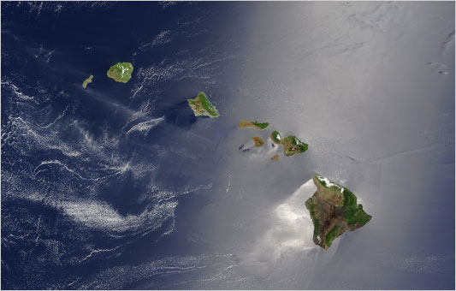

Slide 4

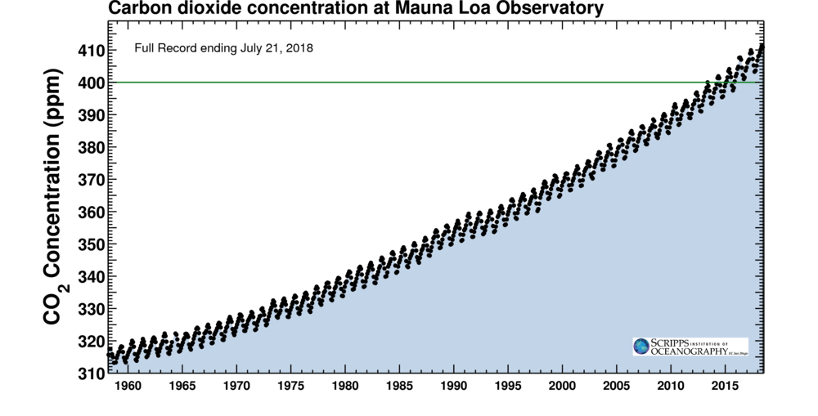

Slide 5
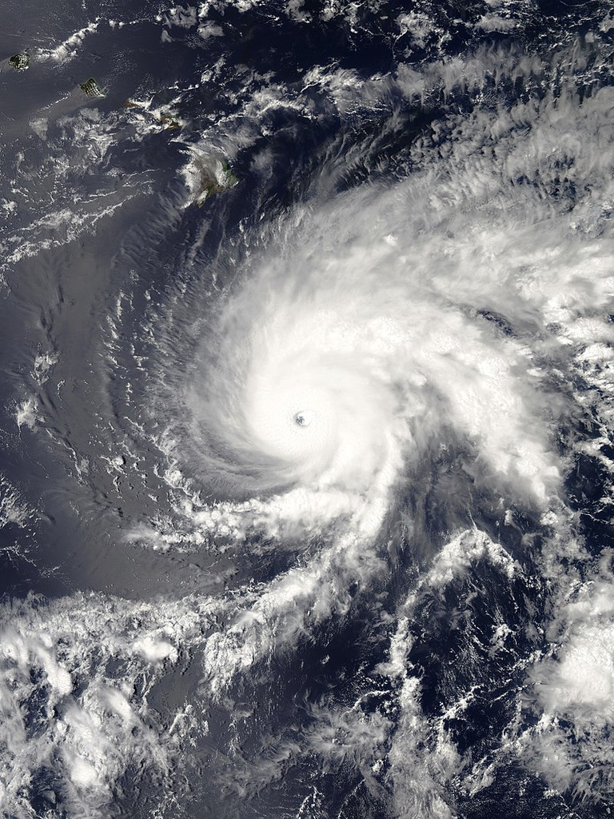

Slide 6
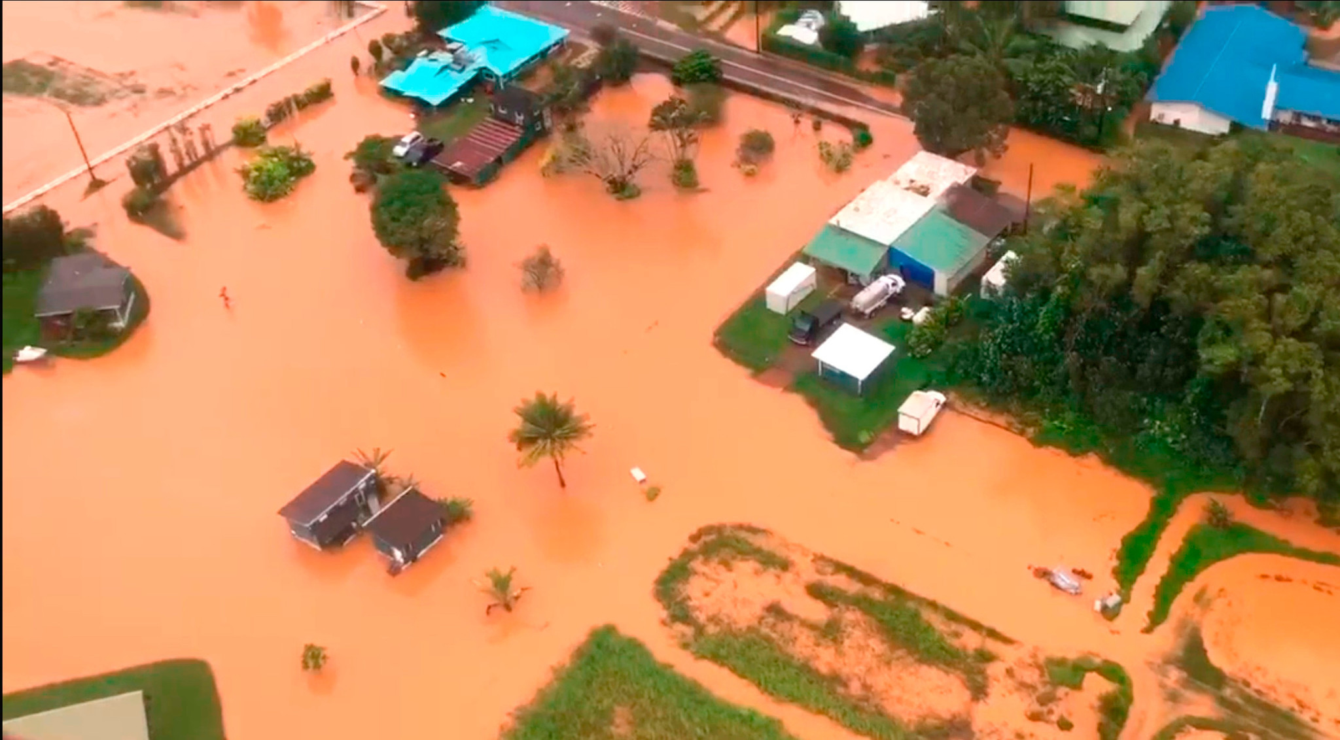


Slide 7
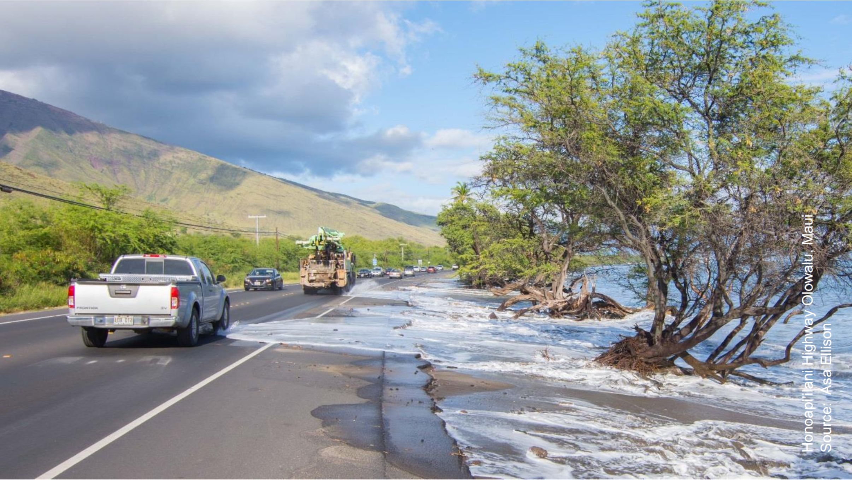

Slide 8
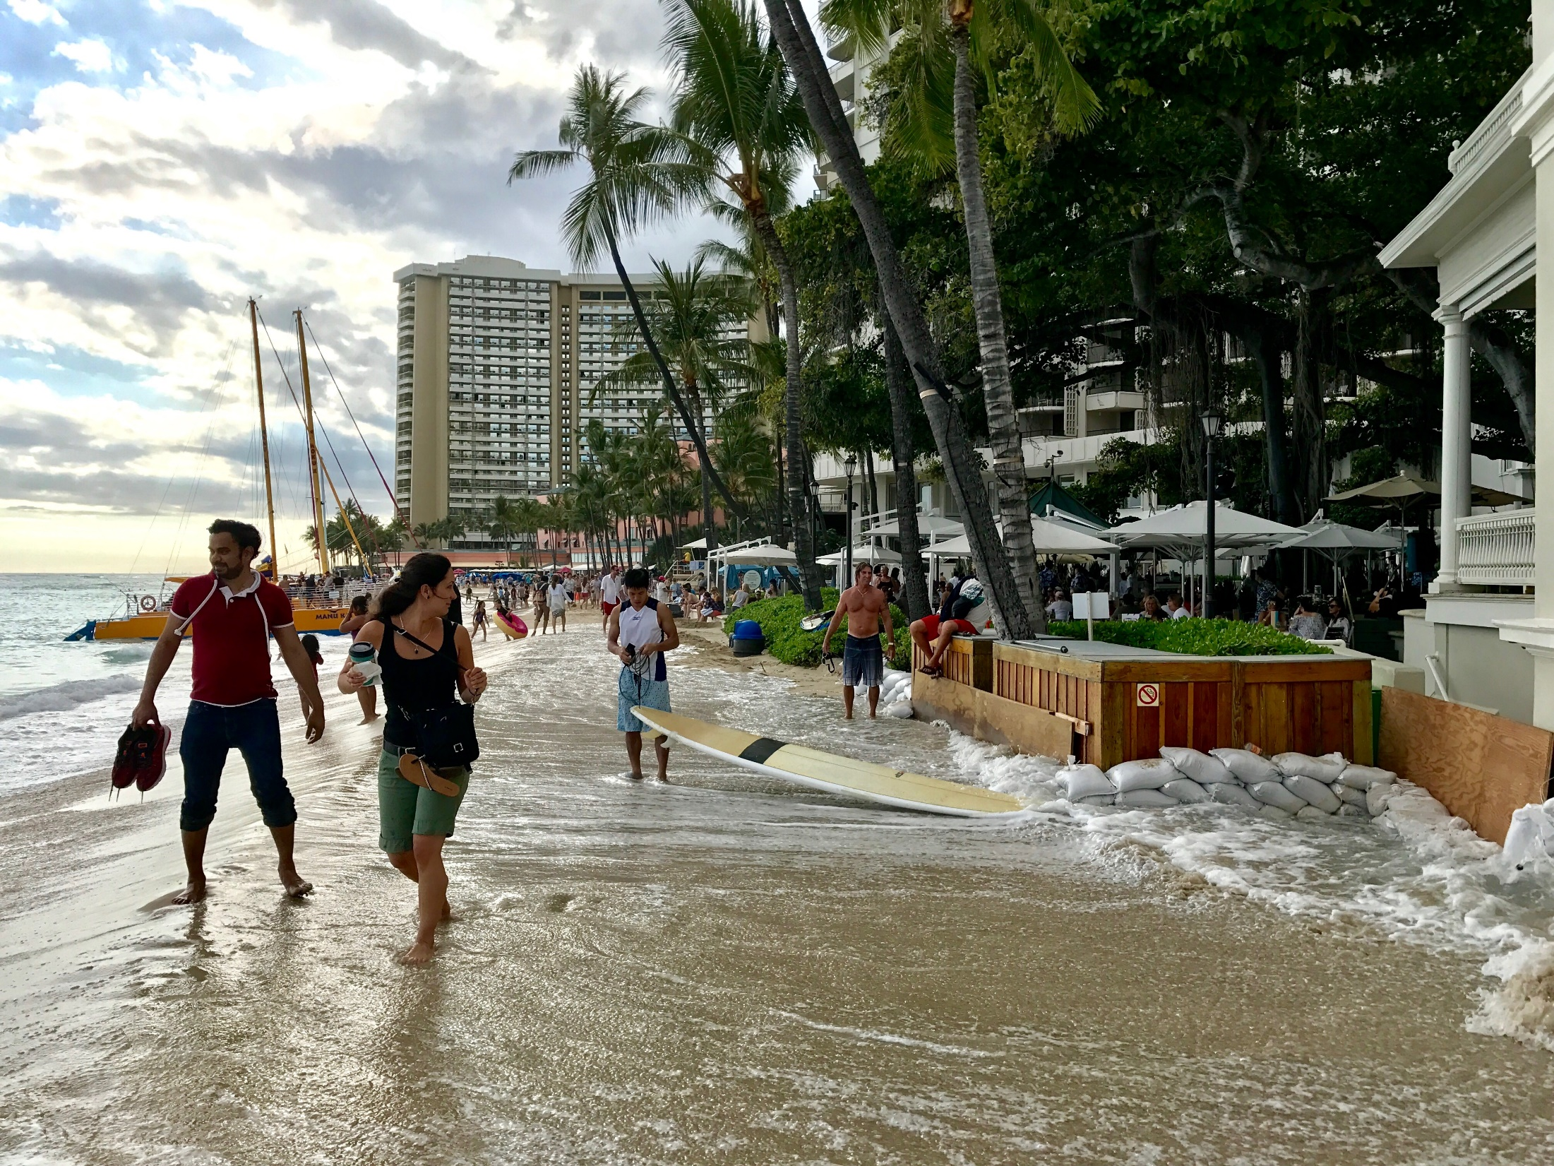

Slide 9
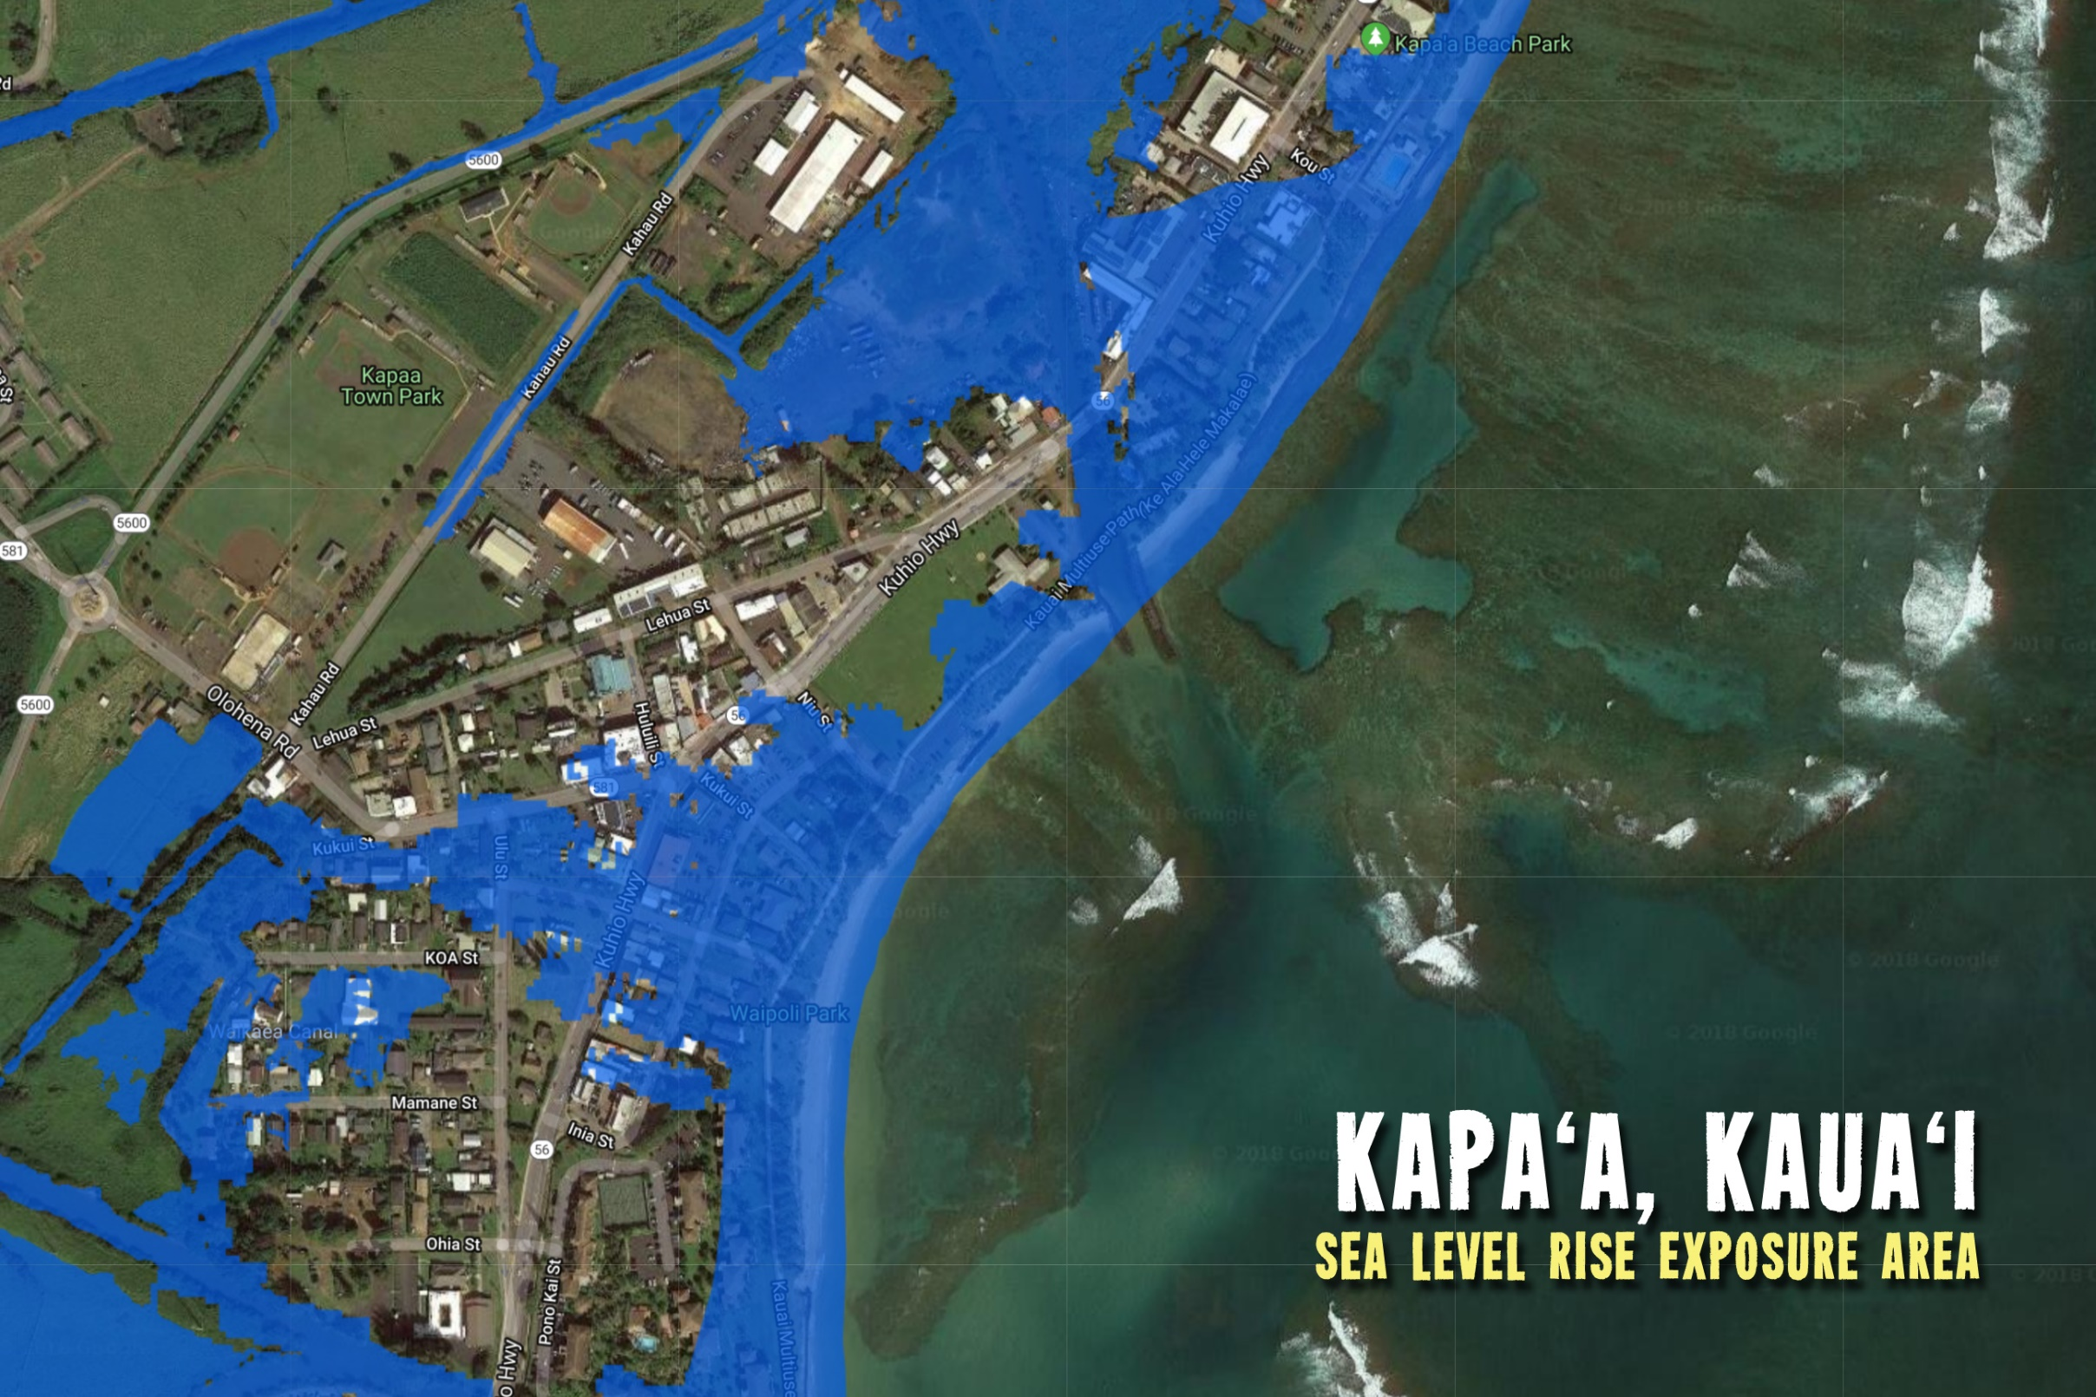
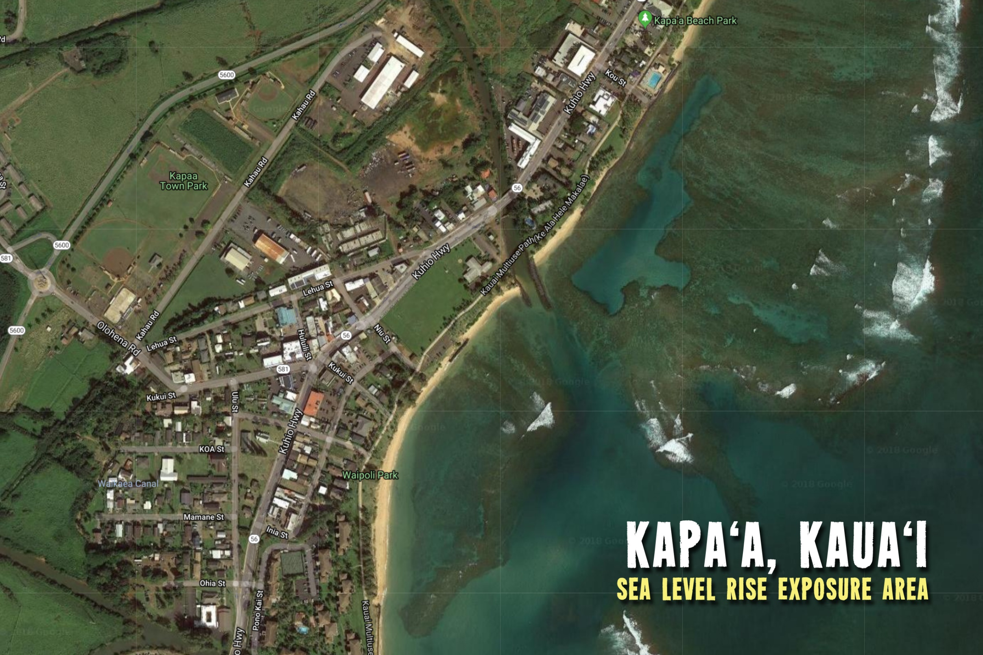

Slide 10
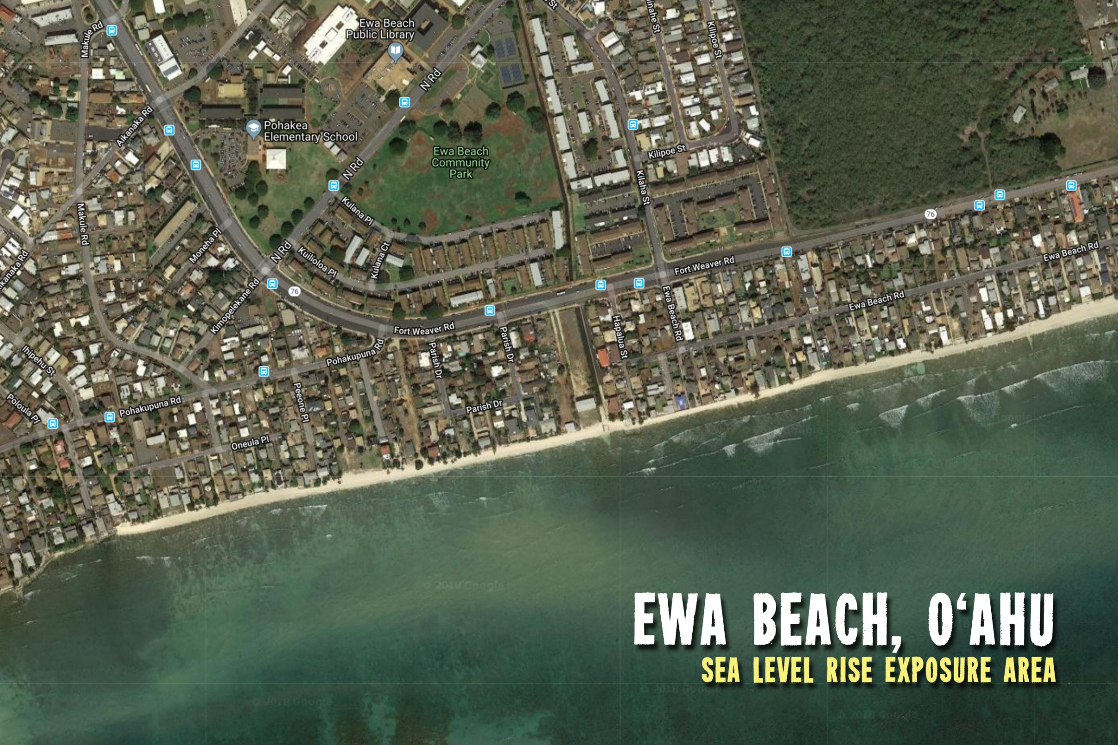
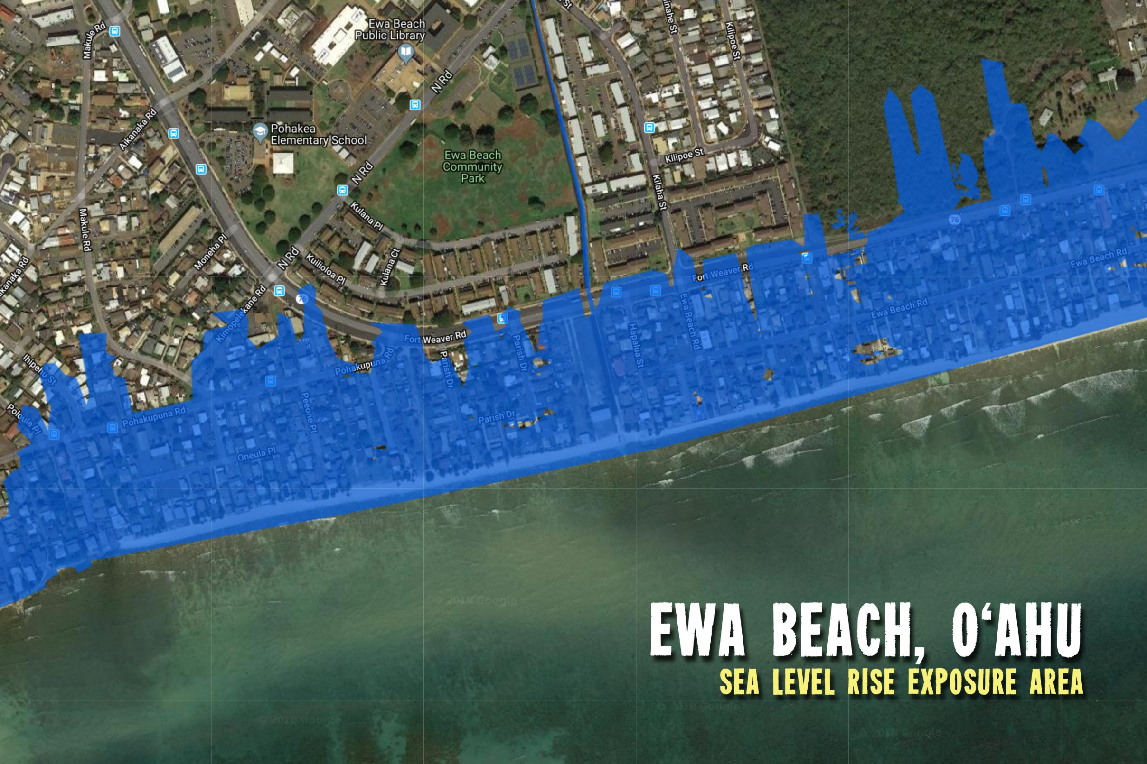

Slide 11
Resilience Strategy Actions
The country’s first Office of Climate Change, Sustainability and Resiliency established on Oahu in 2016
Mandate from Oahu voters that City government focus on implementation of the 2016 Paris Climate Agreement and develop a Resilience Strategy Plan and Climate Action and Adaptation Plan
Like San Juan, Honolulu is one of the 100 Resilient Cities addressing actions to survive, adapt, and thrive despite climate impacts

Slide 12

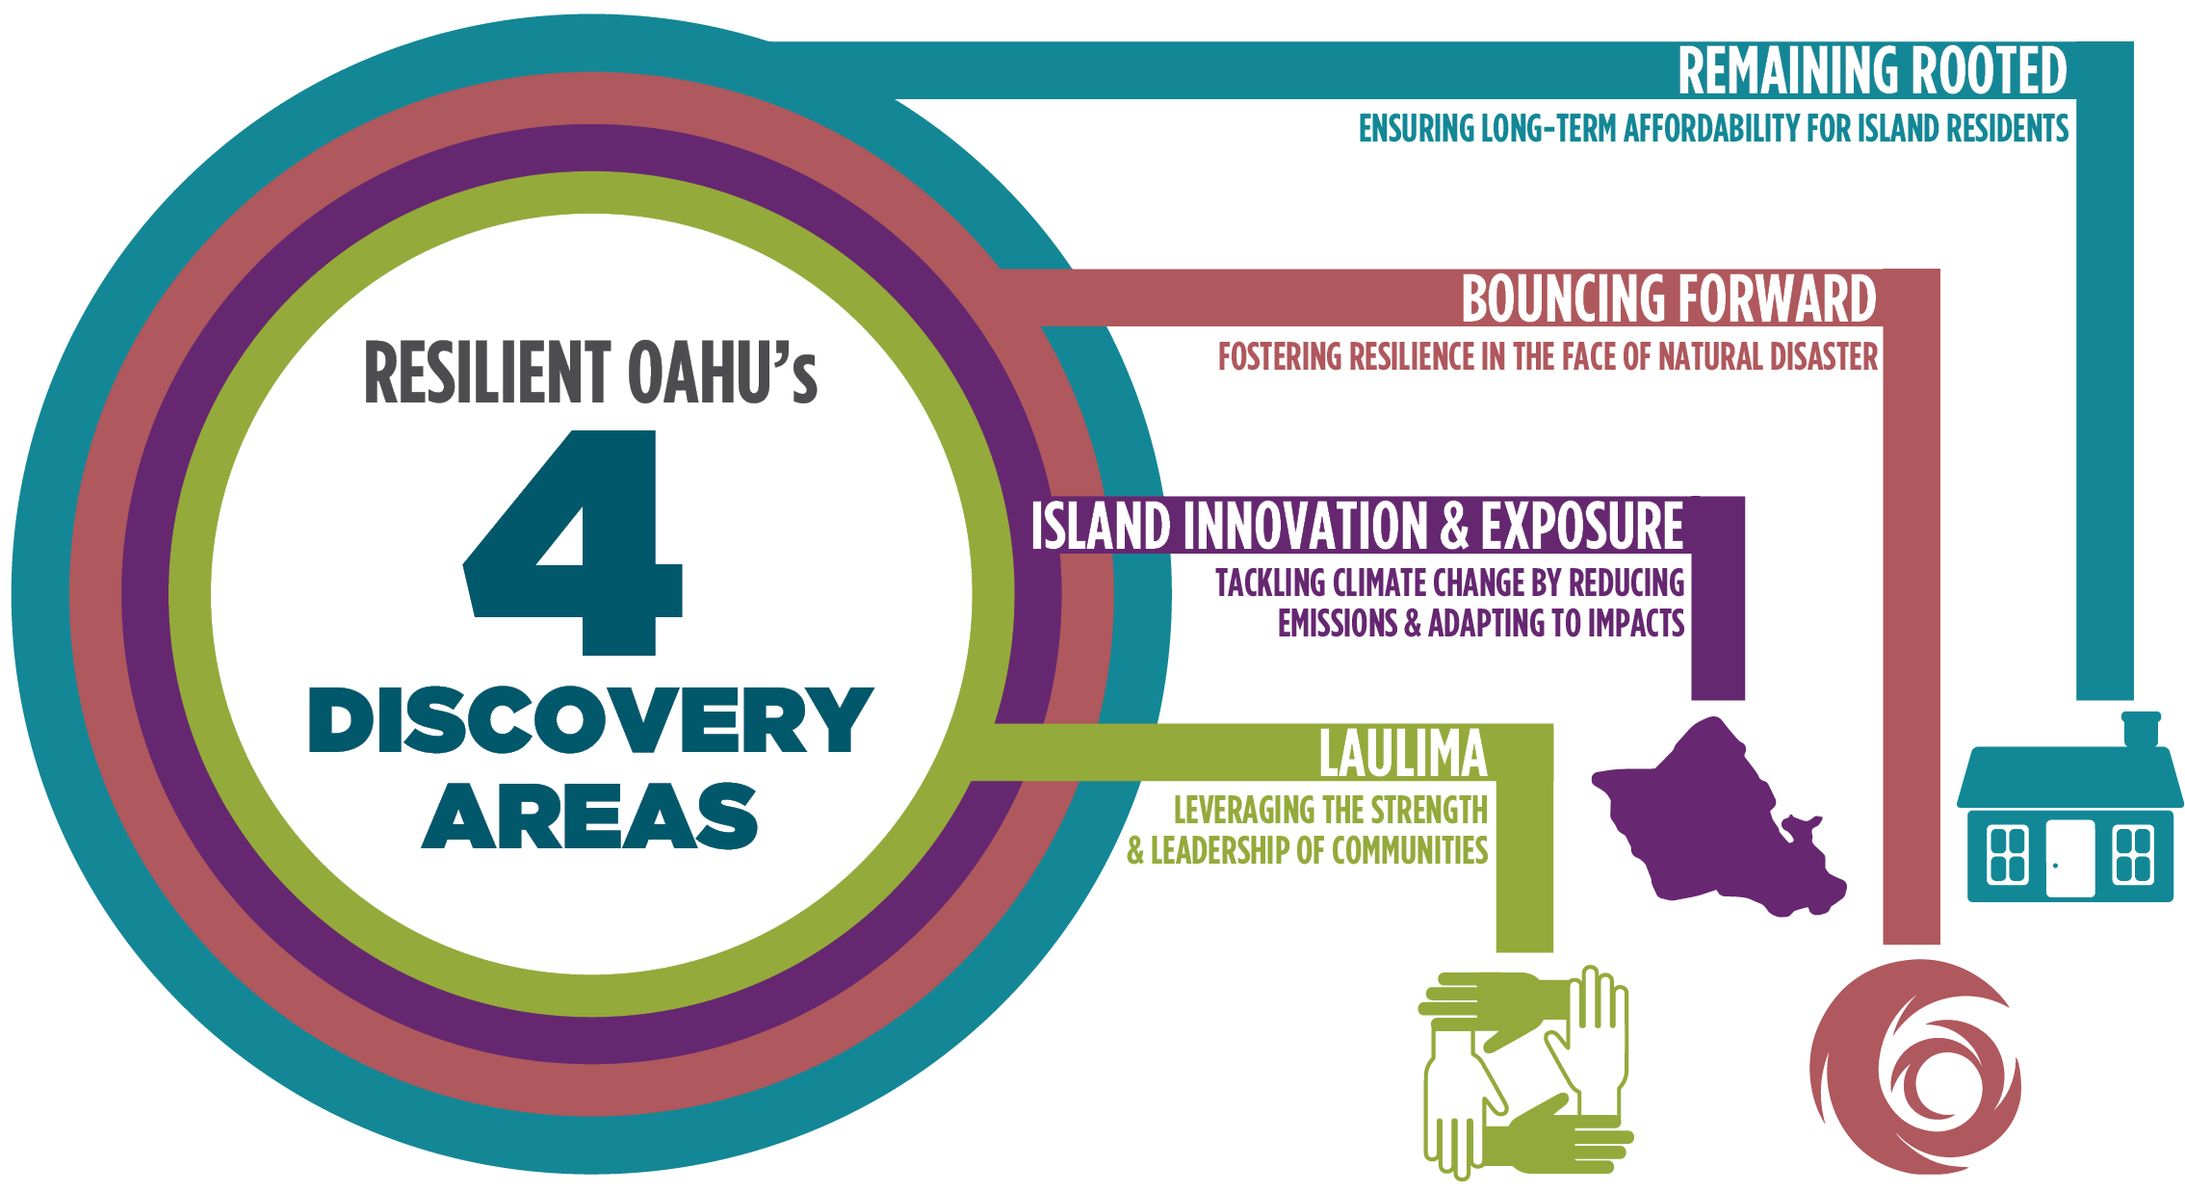
Community Climate Action Plan
  RESILIENCE STRATEGY

Slide 13
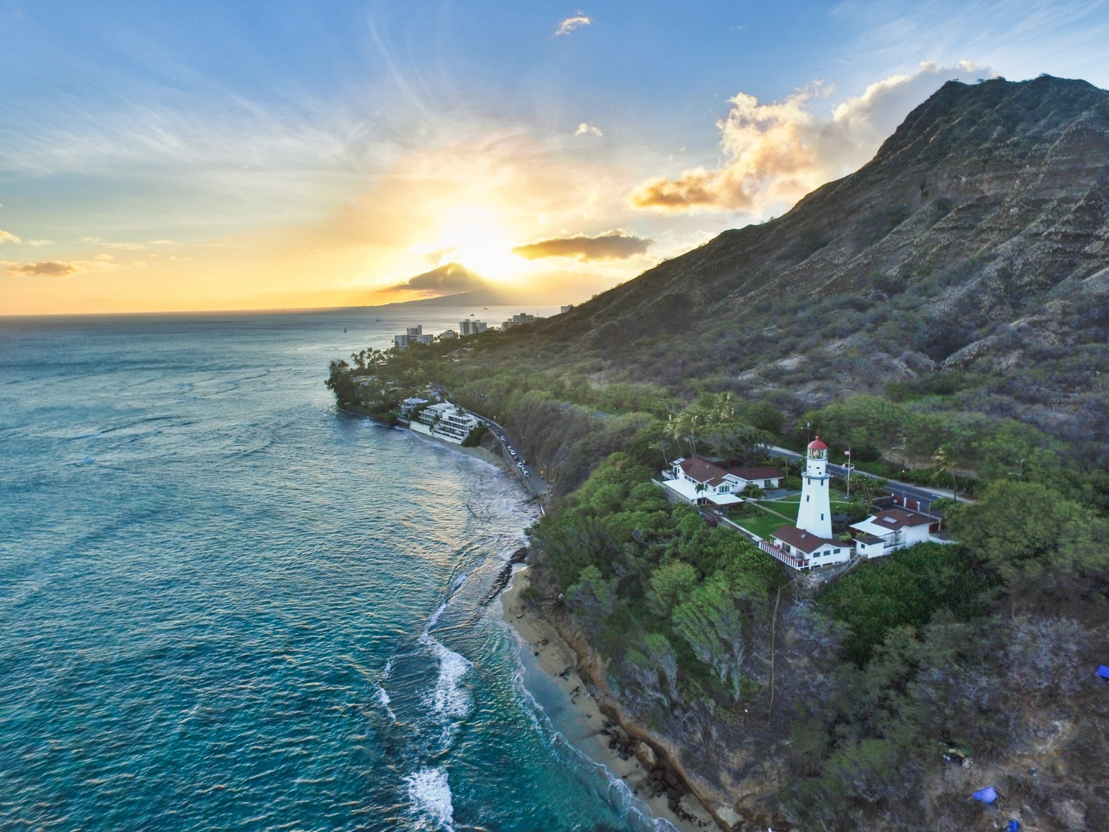
We have everything we need
to change our energy culture.

Slide 14
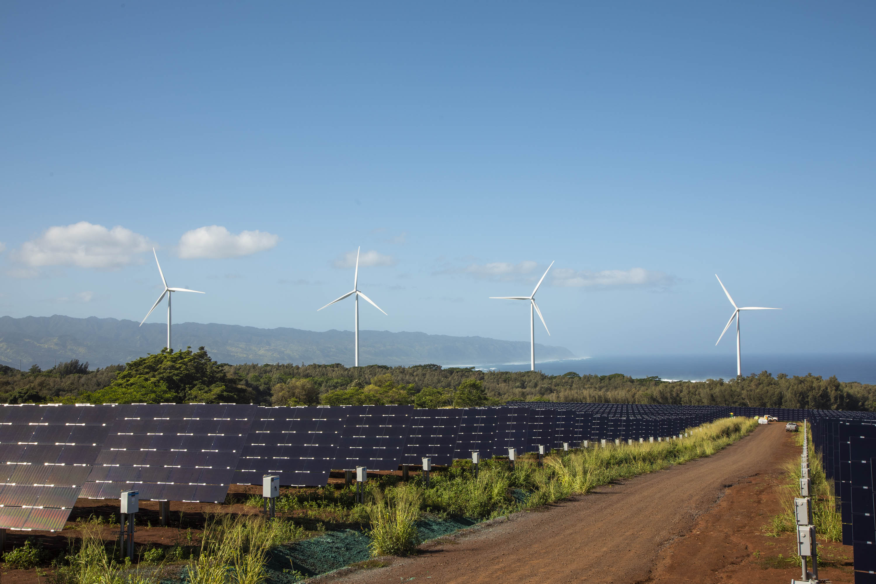

Slide 15
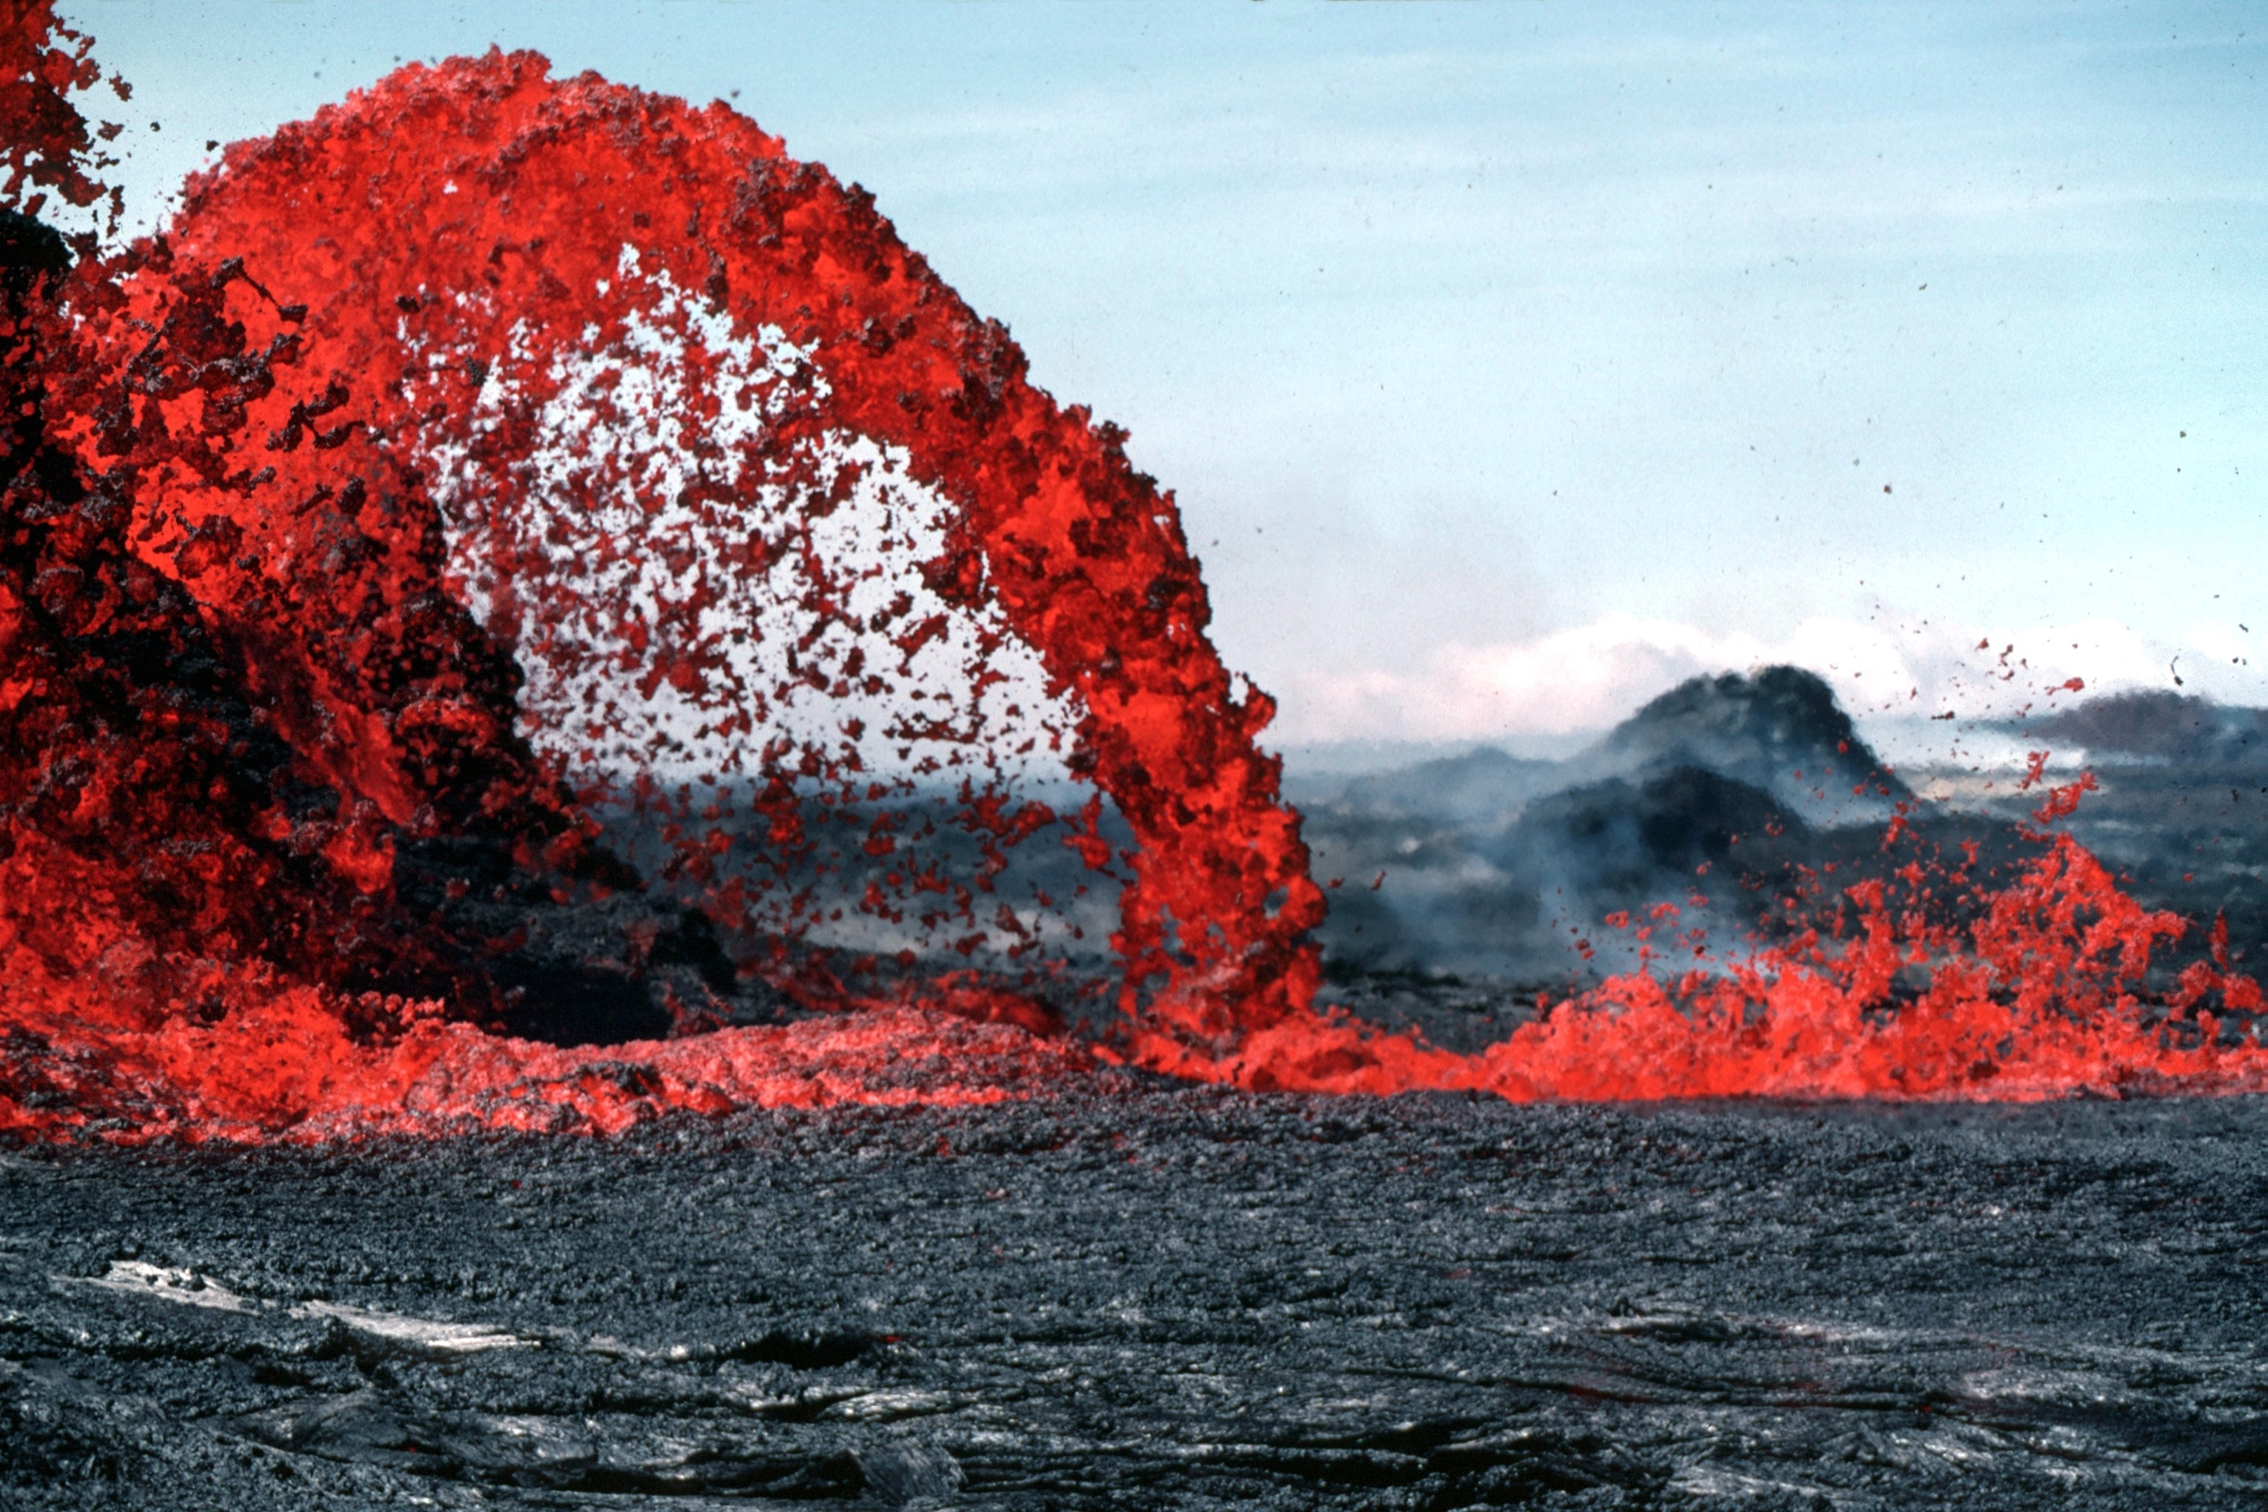

Slide 16
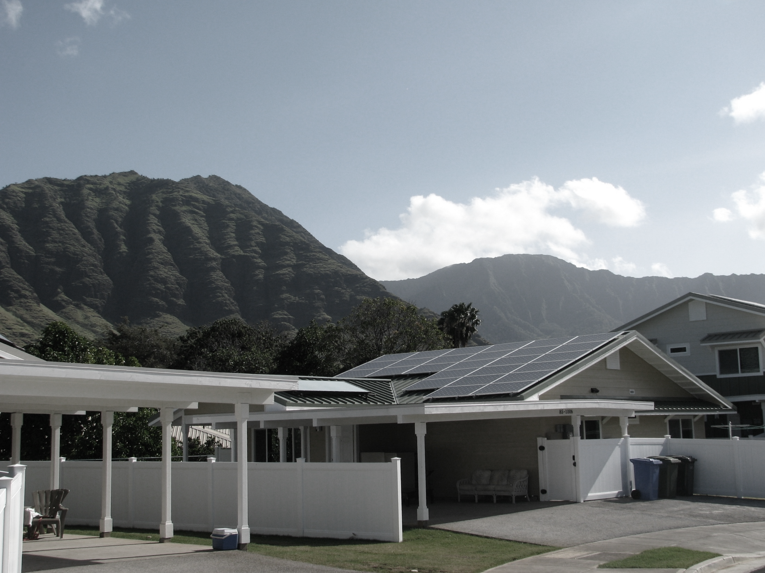
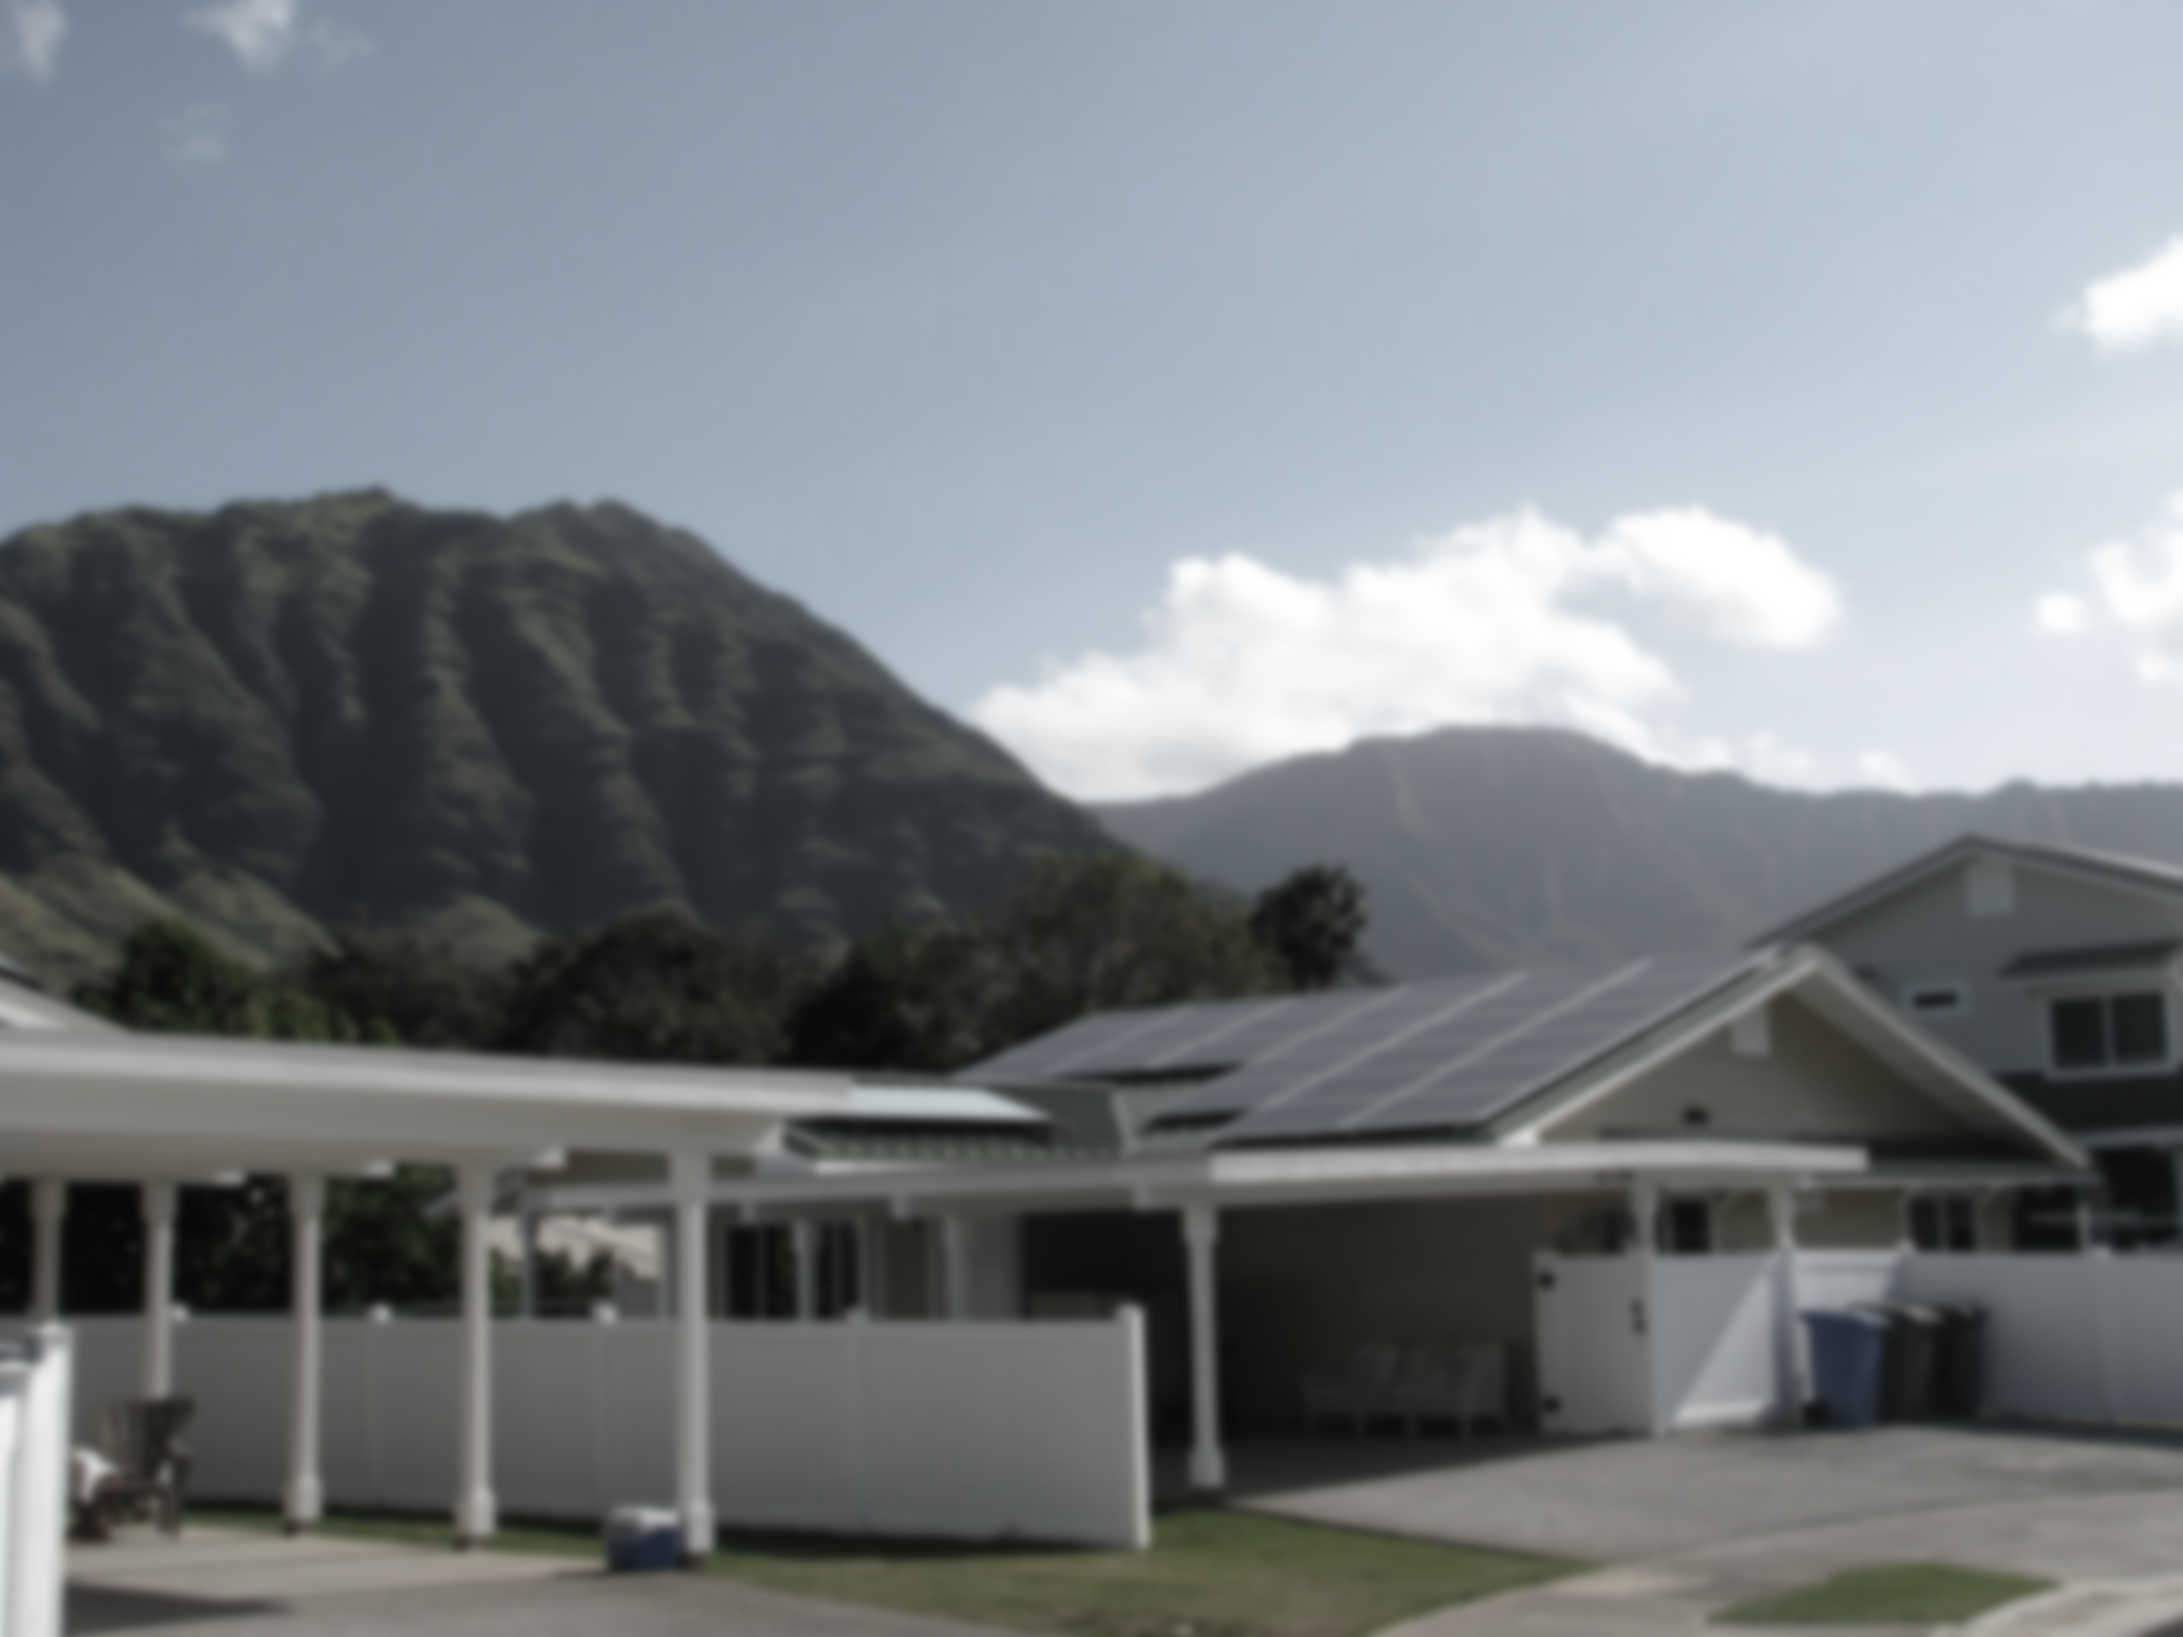


Slide 17
Regulatory Framework for DERs and Grid Modernization in Hawaii
Hawaii PUC Whitepaper: “Inclinations on the Future of Hawaii’s Electric Utilities”, Order 32052, Docket 2012-0036
In April 2014, the PUC set forth policy guidance for usage of distributed energy resources including energy storage technology to provide grid support
Hawaii Legislature in 2015 enacts law to increase the renewable energy portfolio standard for electric utilities to 100% by 2045
Hawaii already had laws in place since 2008 requiring 70% renewable energy by 2050 and 30% energy efficiency portfolio standards
In 2018, HB 2182 was passed to become Act 15 requiring 100% carbon reduction in other sectors and Hawaii to be carbon neutral by 2045

Slide 18
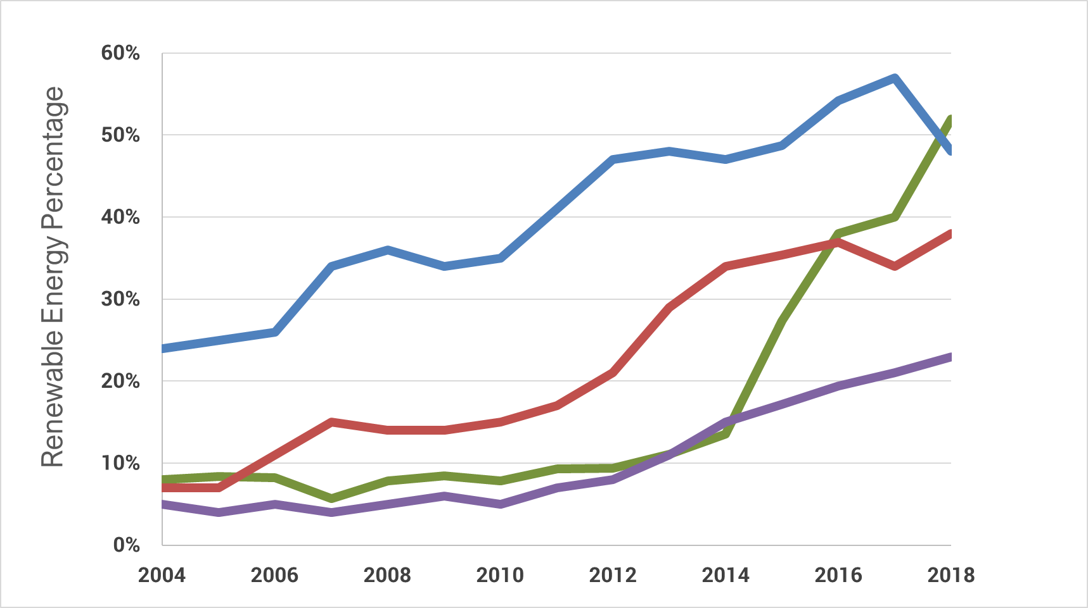
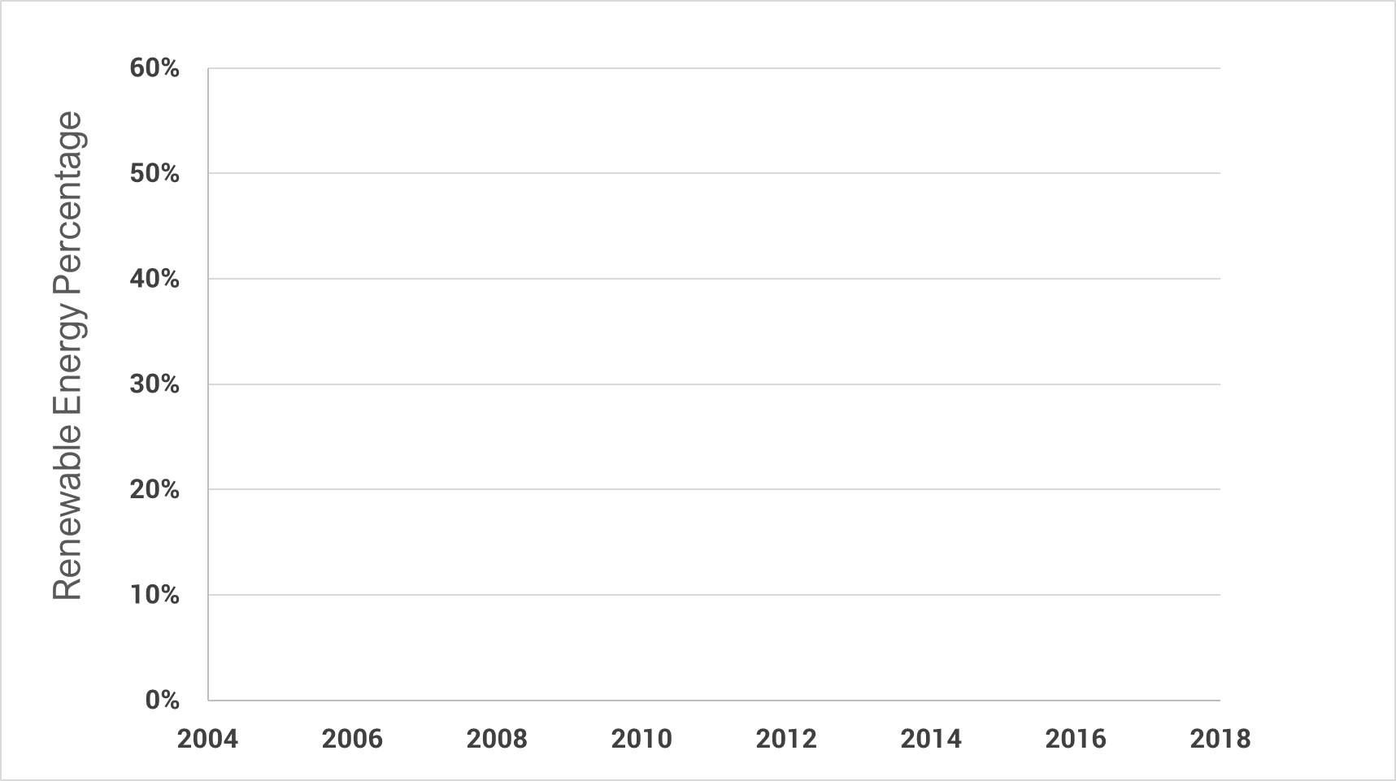





Slide 19
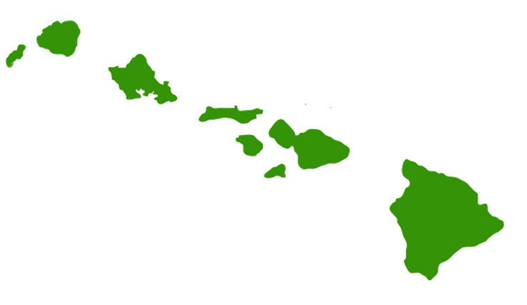

Hawaii Electric Systems – 4 Electric Utilities; 6 Separate Grids; % Renewable
Kauaʻi Island Utility Cooperative
System Peak: 75 MW
77 MW PV, 33 MW AC PV w/ 113 MWh storage, 7 MW Biomass, 9 MW Hydro
(14 MW AC PV, 70 MWh storage under construction)
Installed PV ≡ 103% of System Peak
Maui Electric
Maui System Peak: 199 MW
110 MW PV, 72 MW Wind (60 MW more PV & storage under review)
Installed PV & Wind≡ 91% of System Peak
Lana’i System Peak: 5.4 MW
2.8 MW PV (52% of System Peak)
Moloka’i System Peak: 5.9 MW
2.2 MW PV (37% of System Peak)
(+2.64 MWac PV under review)
Kauaʻi
42%
Oʻahu
21%
Molokaʻi
Maui
34%
Hawaiʻi Electric Light
System Peak: 191 MW
90 MW PV, 32 MW Wind, 38 MW Geothermal, 16 MW Hydro
(50 MW more under review)
Installed PV & Wind ≡ 64% of System Peak
Lanaʻi
Hawaiʻi
Hawaiian Electric
System Peak: 1,209 MW
502 MW PV, 99 MW Wind, 69 MW WTE
(220 MW more under review)
Installed PV & Wind ≡ 50% of System Peak
57%
%
Renewable

Slide 20
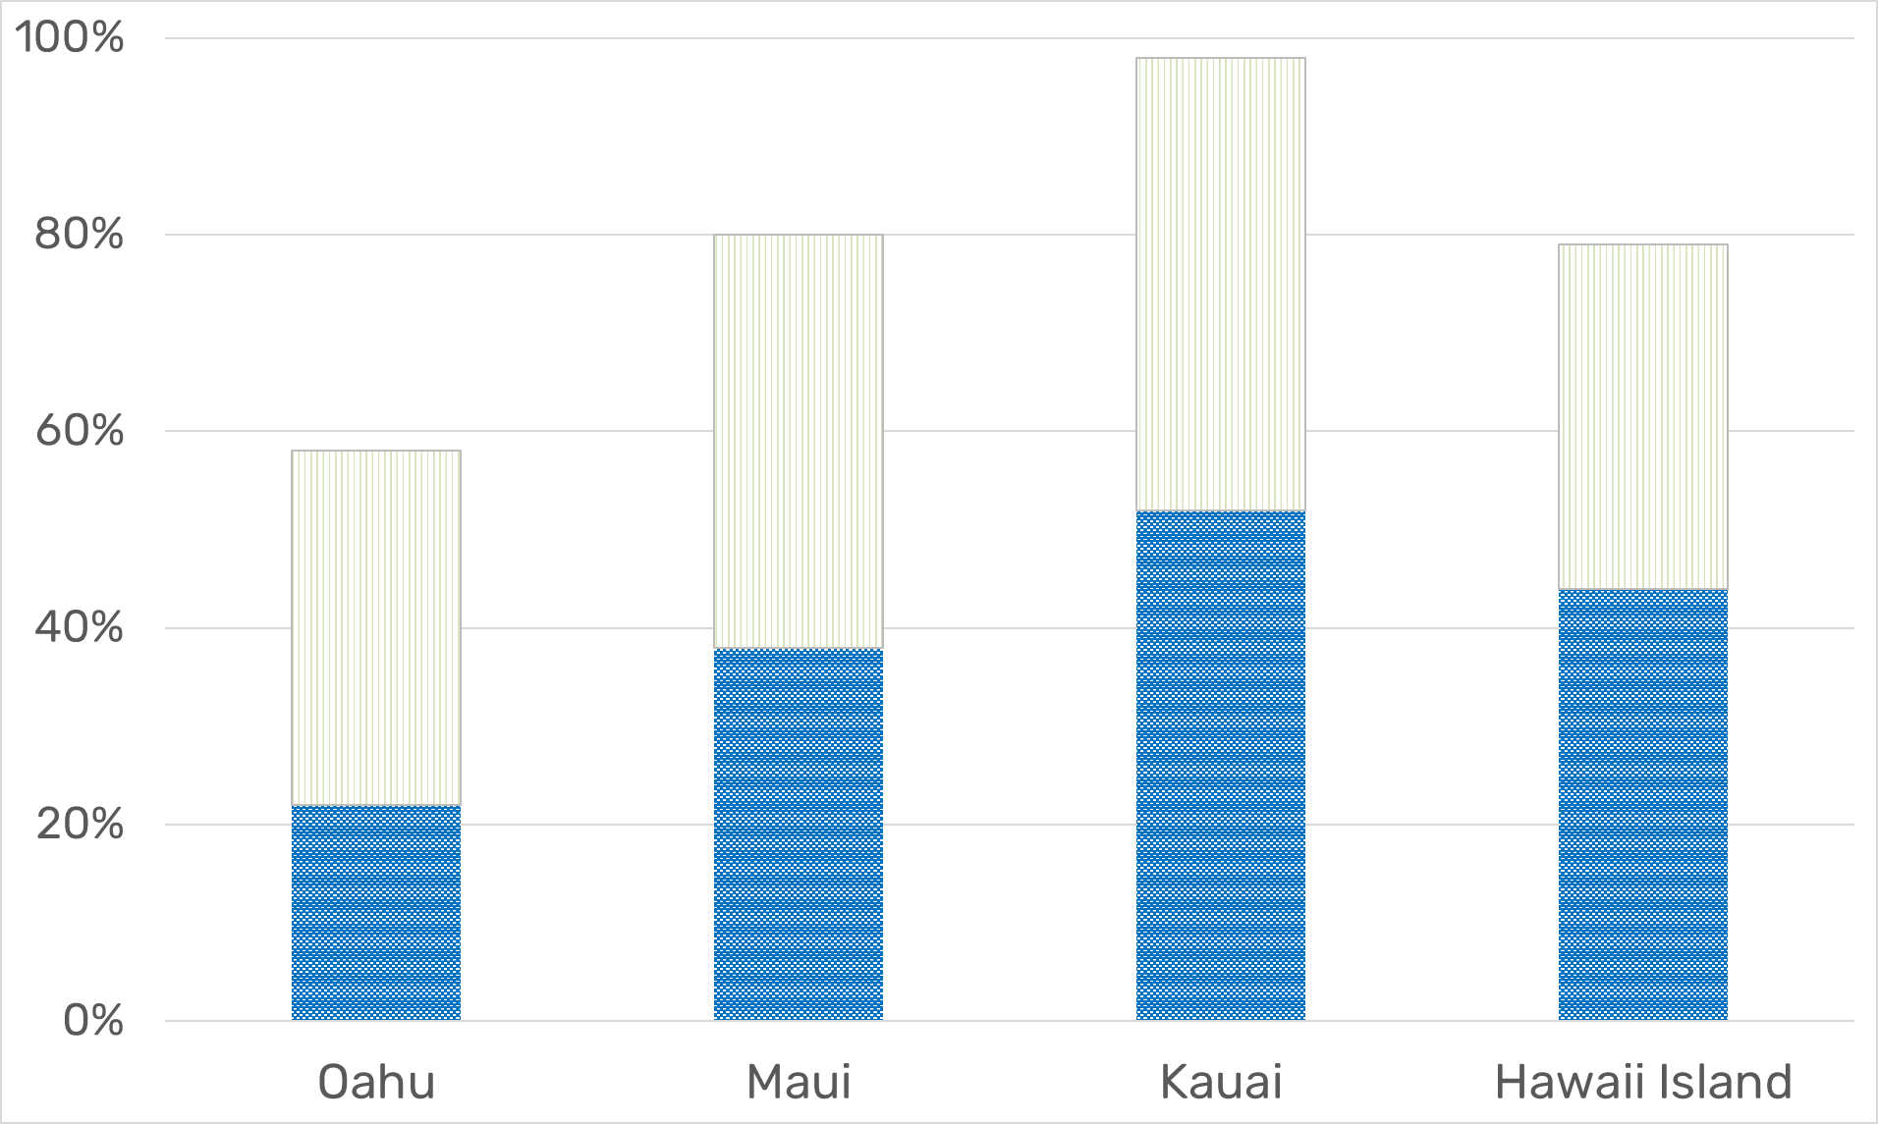
Maximum
Average

Slide 21
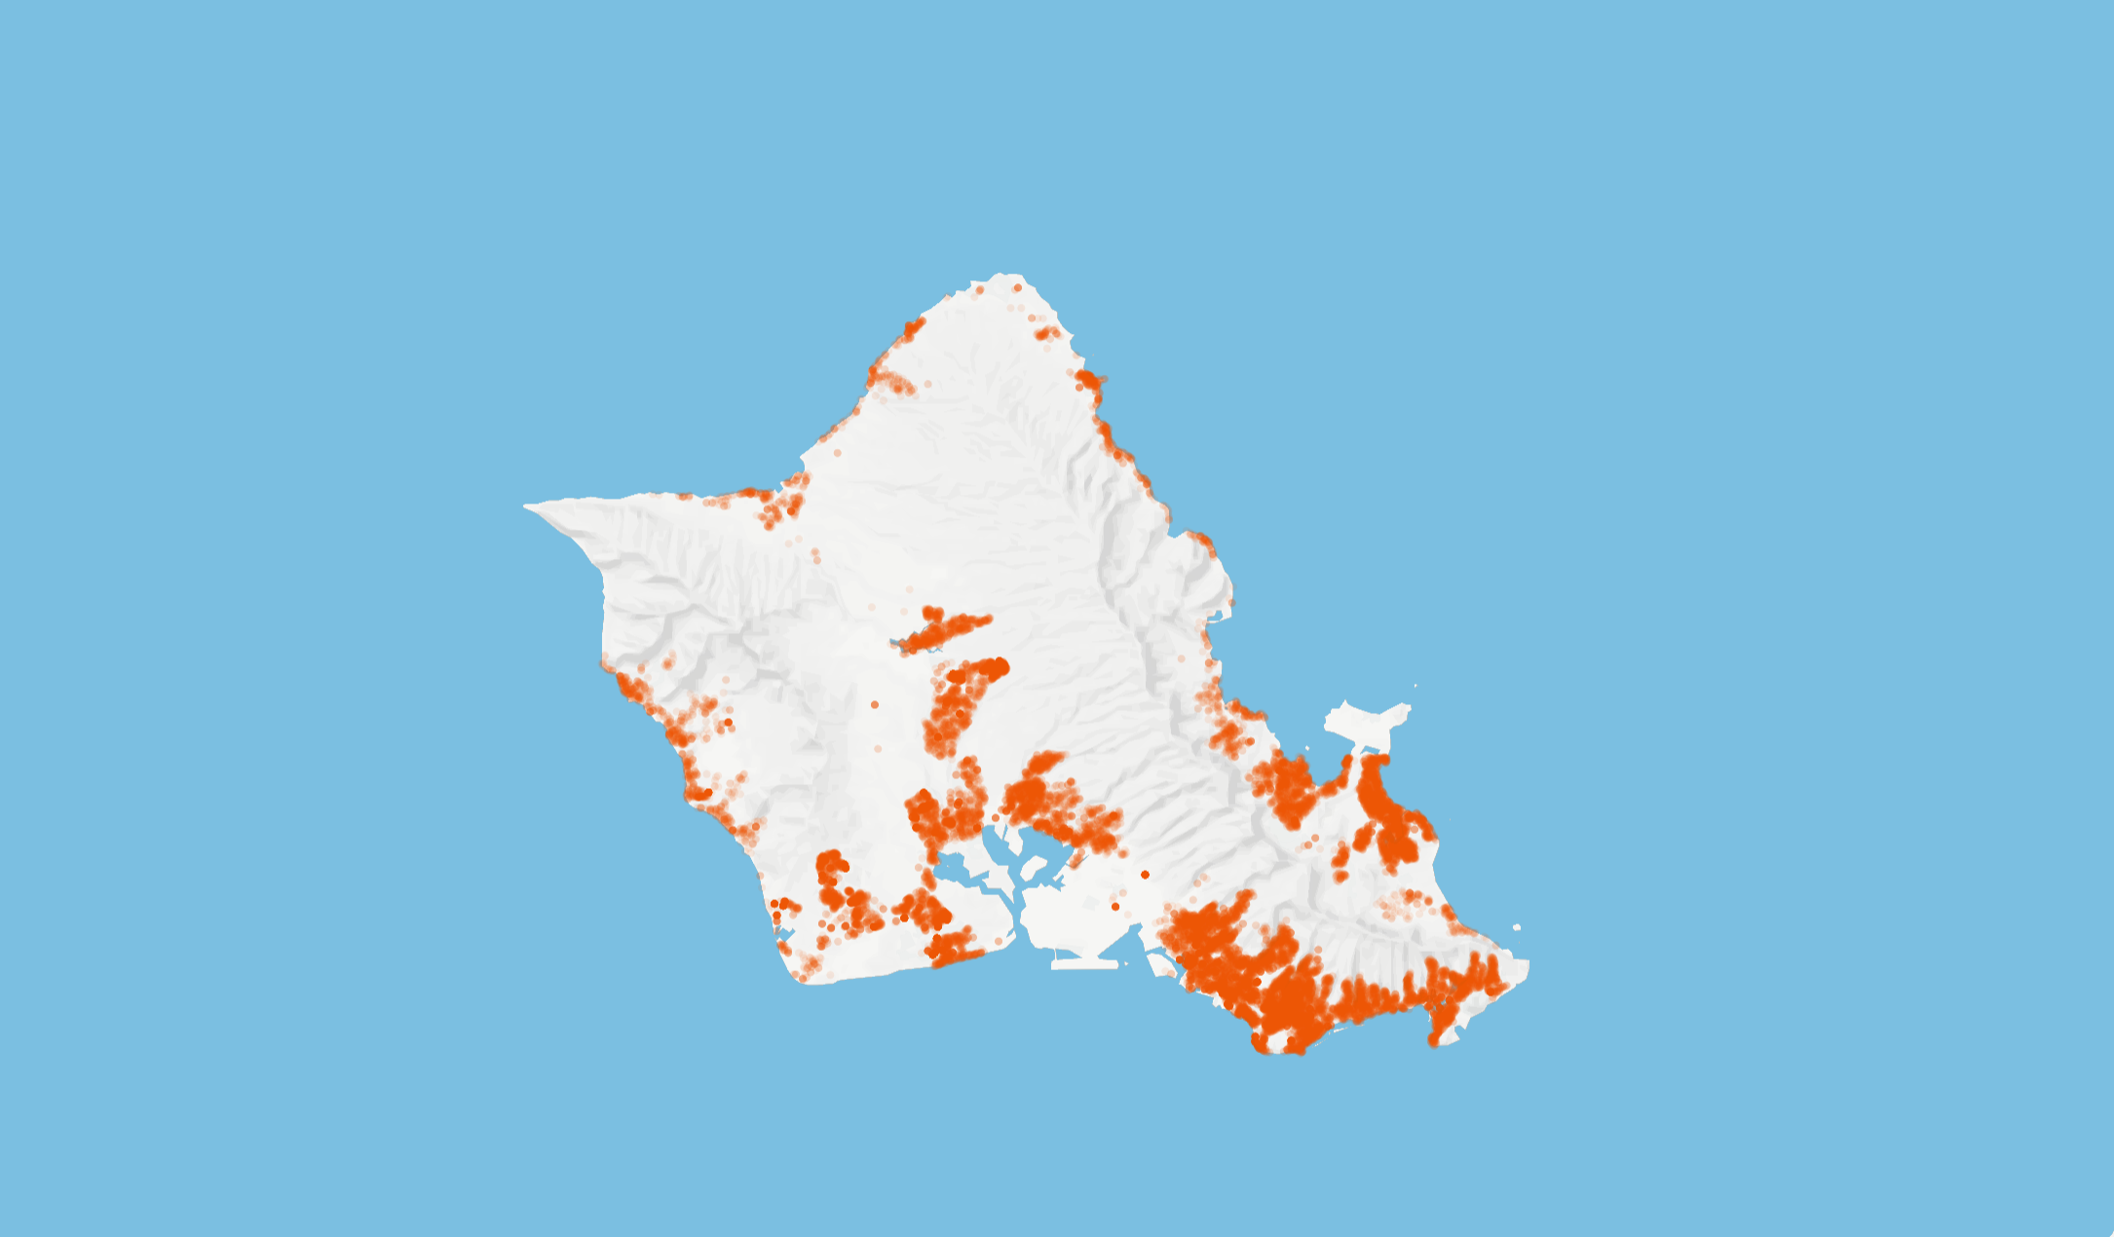


Slide 22
Key Hawaii PUC Dockets
Smart Export and Customer Grid Supply Plus Storage Tariffs, Order 35266, Docket 2014-0192
Demand Response Tariffs for grid ancillary services, Docket 2015-0412
Grid Modernization, Order 35268, Docket 2017-0226
Community Based Renewable Energy Tariff, Order 34388, issued on 2/10/17, Docket 2015-0389

Slide 23

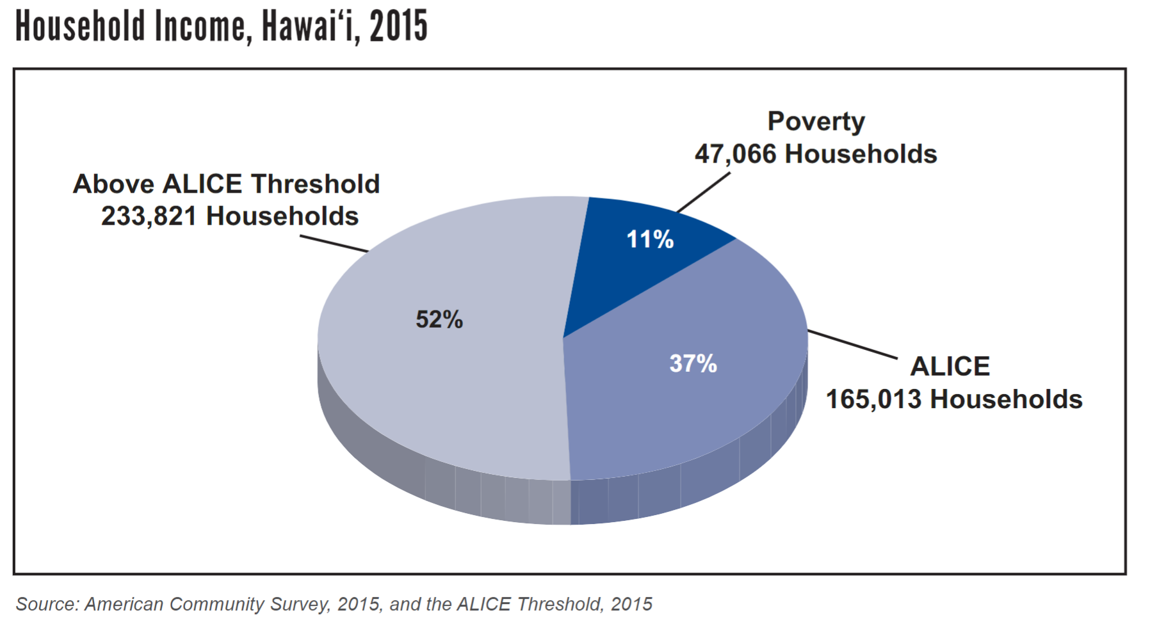

Slide 24


Slide 25
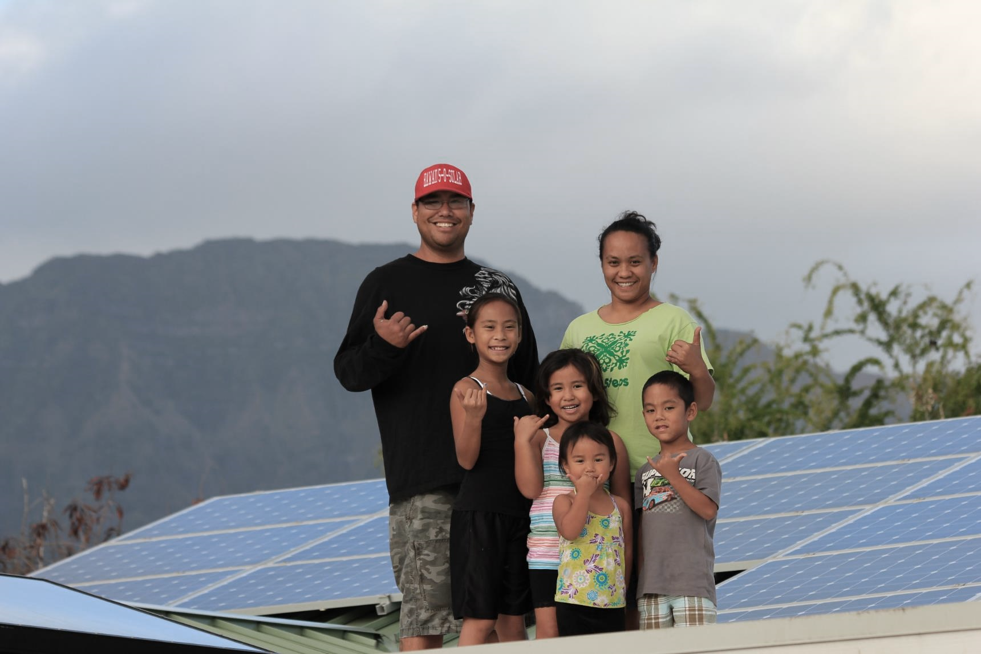

Slide 26
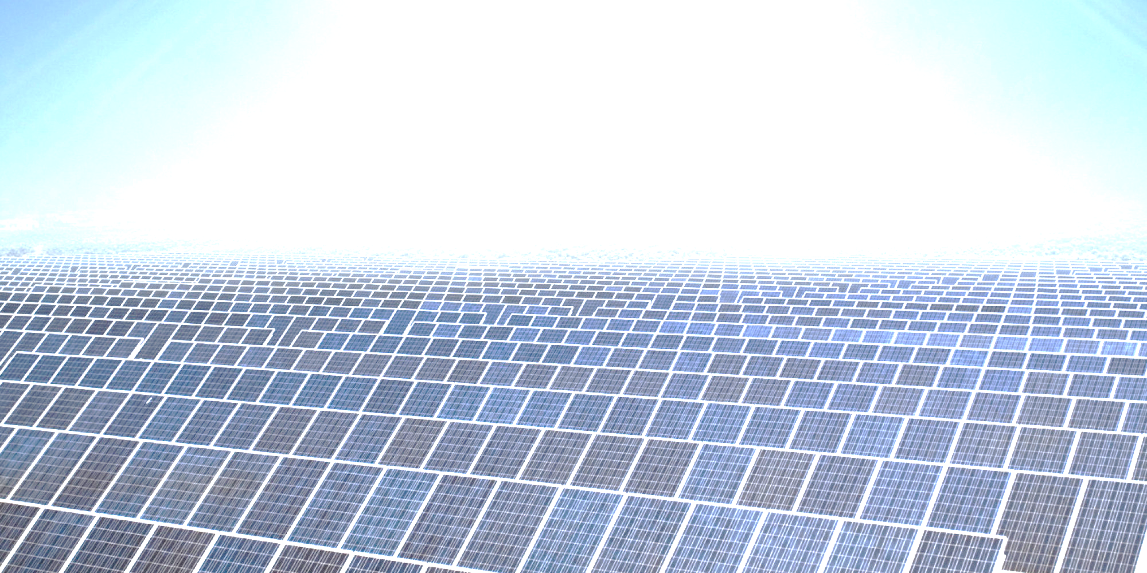
Unsubsidized solar energy price record lows
March 2016: 3.6 cents per kWh (Mexico)
May 2016: 2.99 cents per kWh
(Dubai Electricity and Authority for Water)
August 2016: 2.91 cents per kWh (Chile)

Slide 28

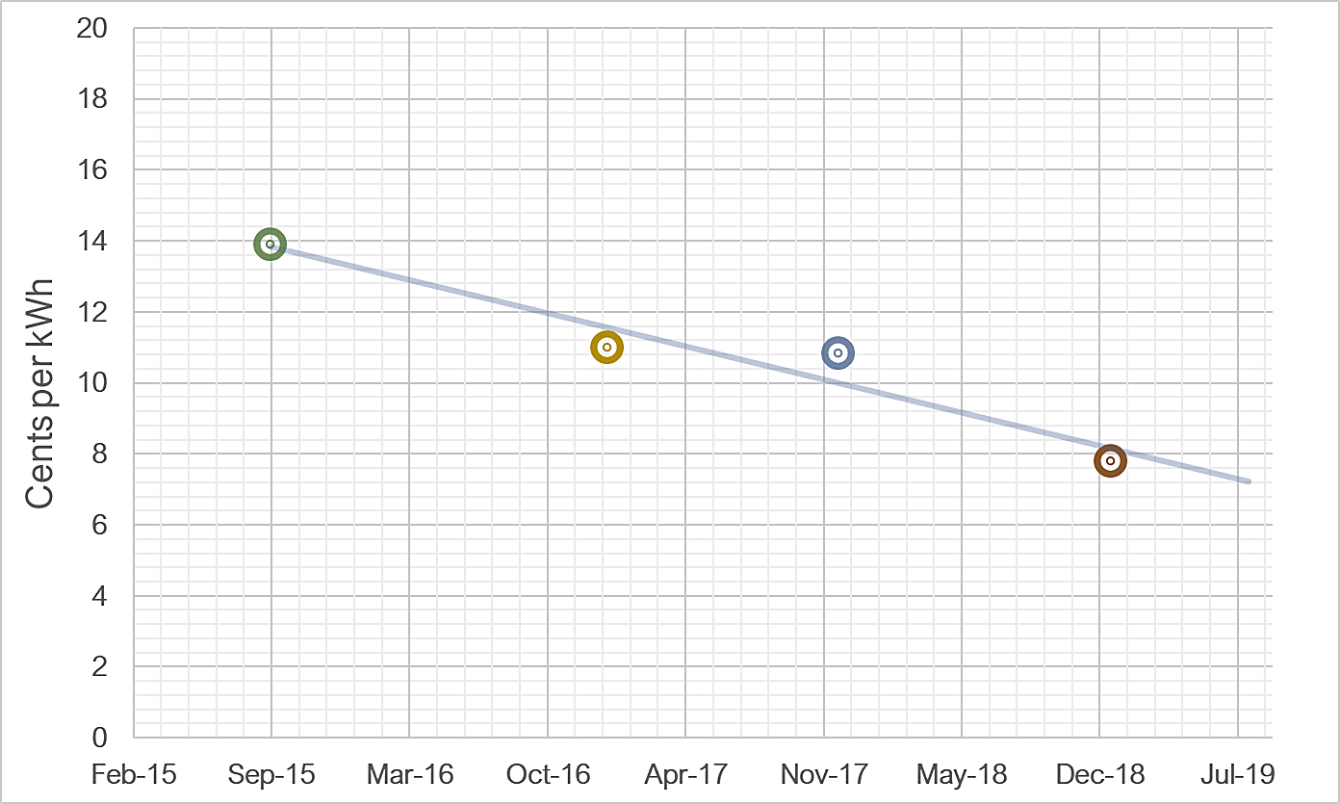

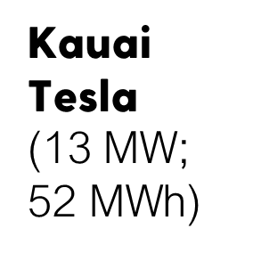
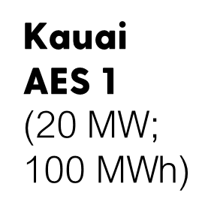
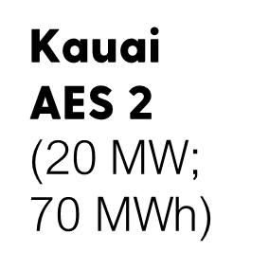
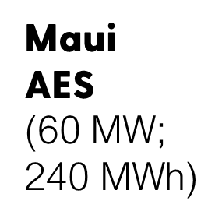

Slide 29
Other Key PUC dockets
Hawaii PUC is investigating the implementation of performance based regulation and the establishment of performance metrics in Docket 2018-0088
Hawaii PUC Docket 2018-0163 is underway to provide the regulatory framework for the establishment of microgrid services tariff rules; Puerto Rico already adopted microgrid regulations in June 2018
Hawaii PUC reviewing Hawaiian Electric’s electrification of transportation (EOT) strategic roadmap filed in March 2018 and updated on November 29, 2018 in Docket 2016-0168. The proposed EOT roadmap is available at www.hawaiianelectric.com/EoT
In Docket 2018-0165 Hawaii PUC is reviewing Hawaiian Electric’s integrated grid plan (IGP) Report filed in July 2018 to provide guidance and directives where necessary and appropriate regarding the integrated grid planning process

Slide 30
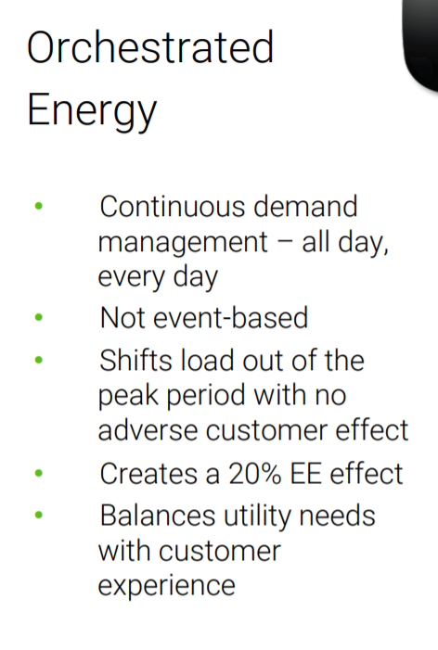



Slide 31
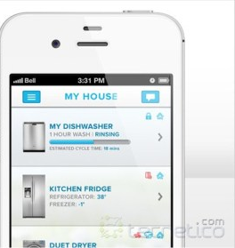
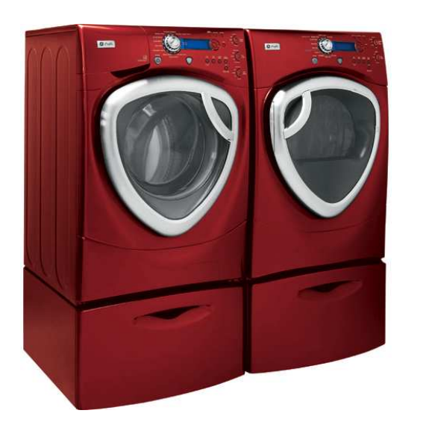
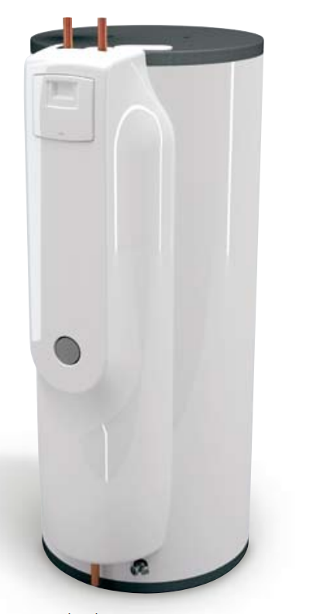
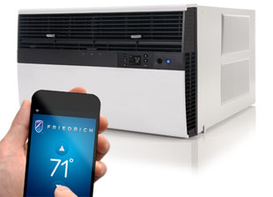


Slide 32
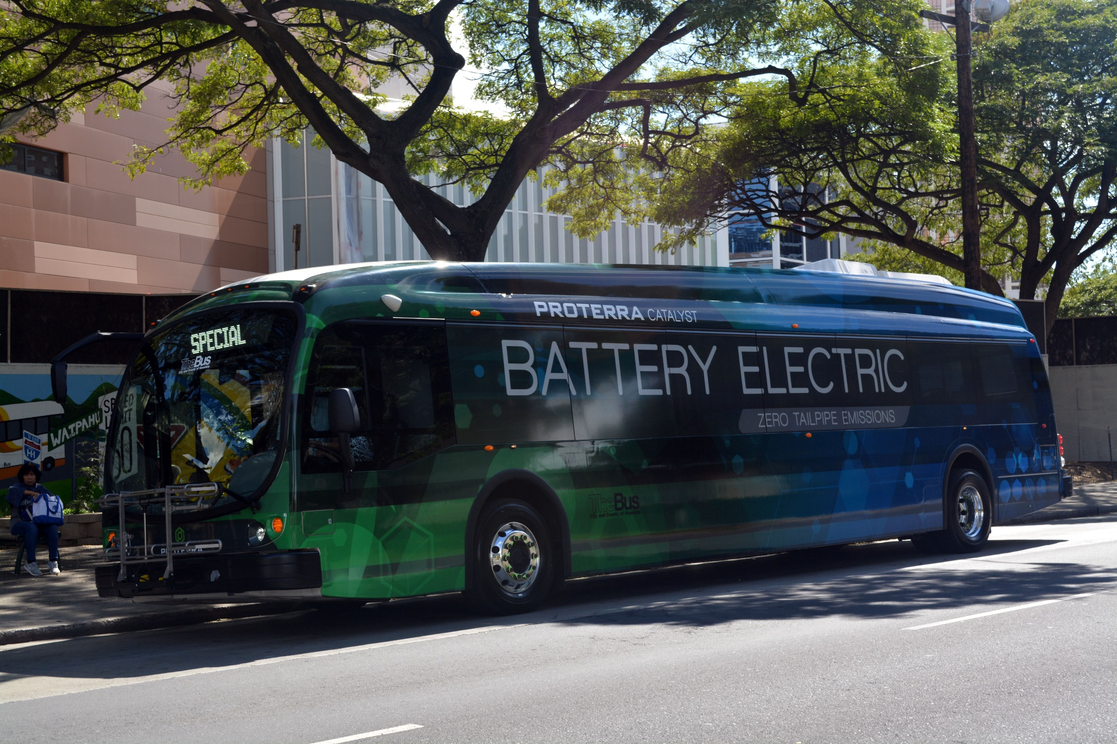

Slide 33
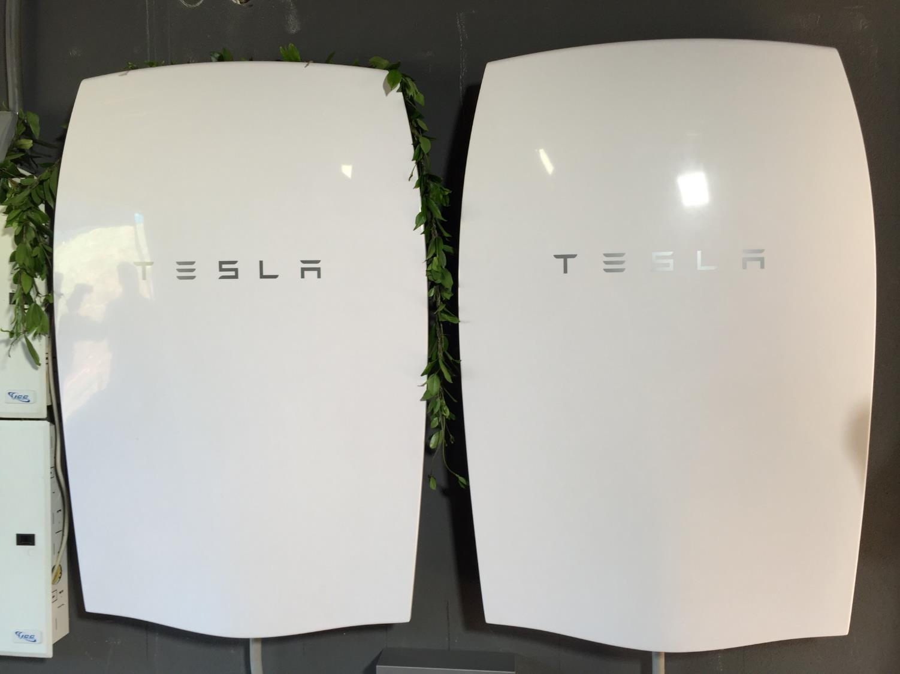


Slide 34

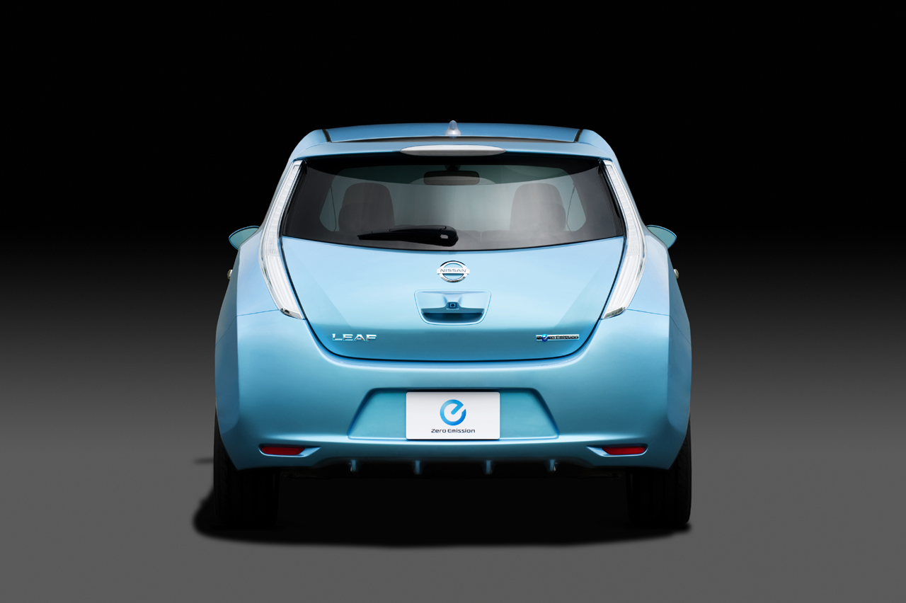
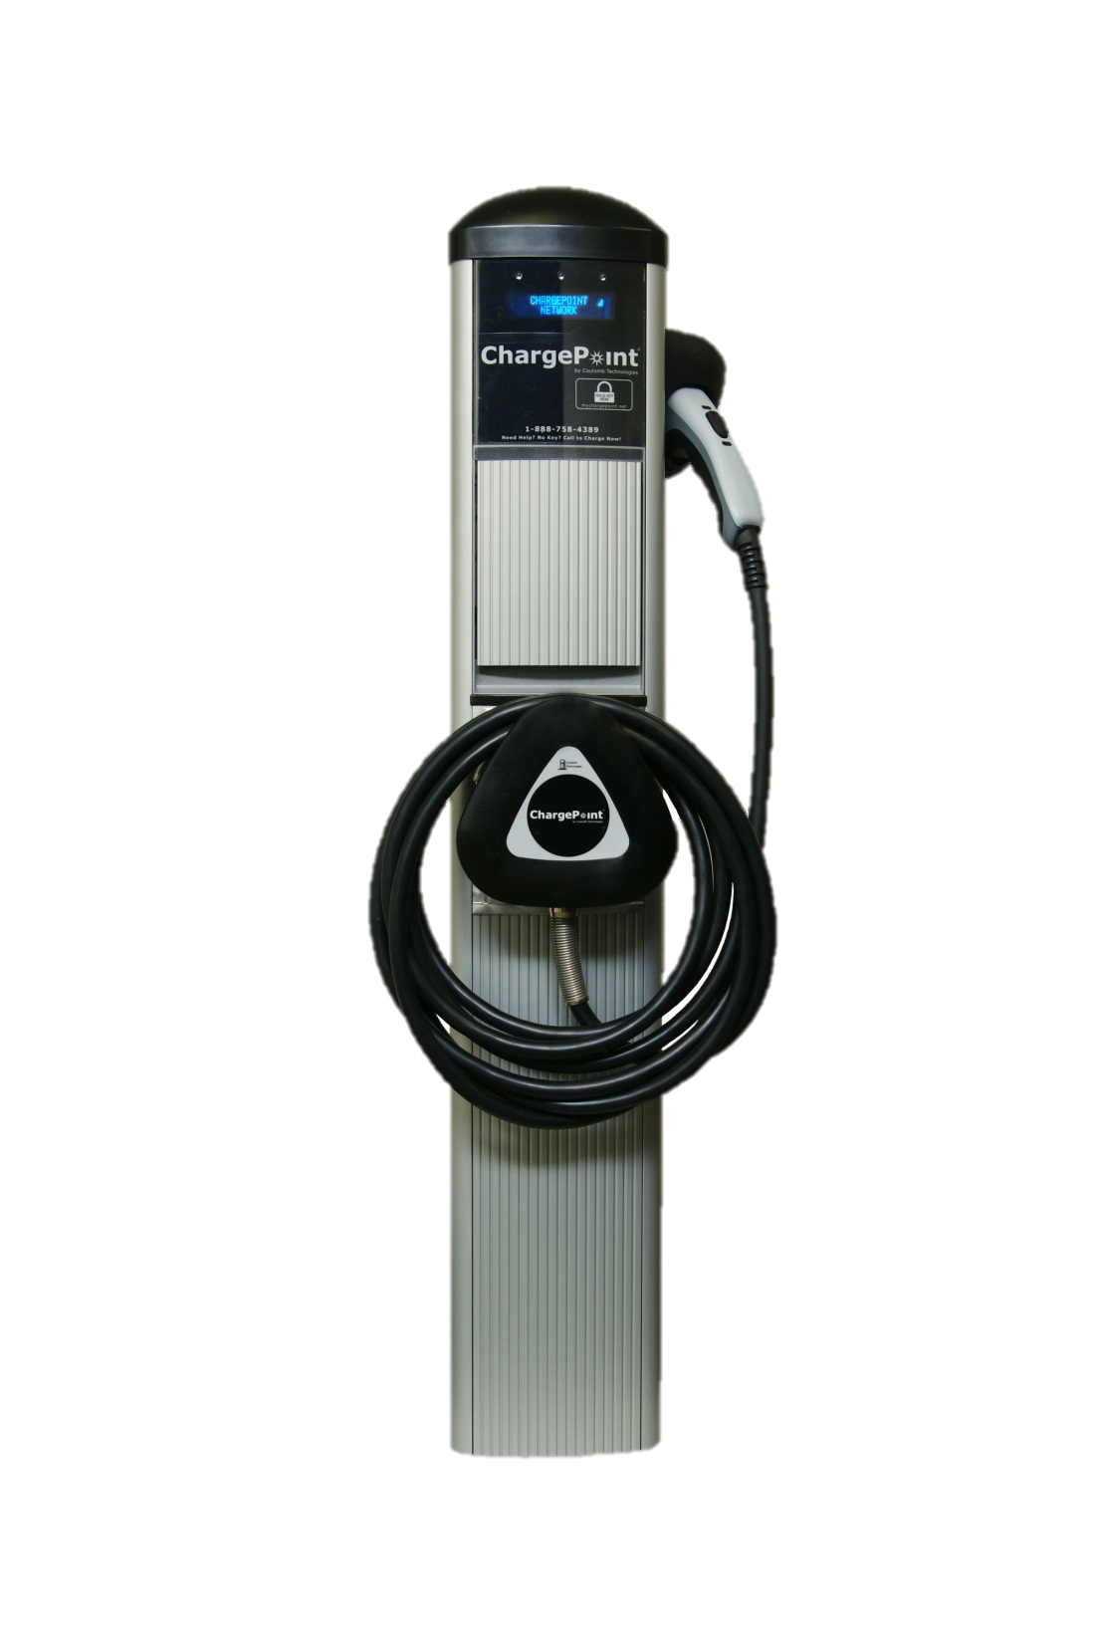

Slide 36

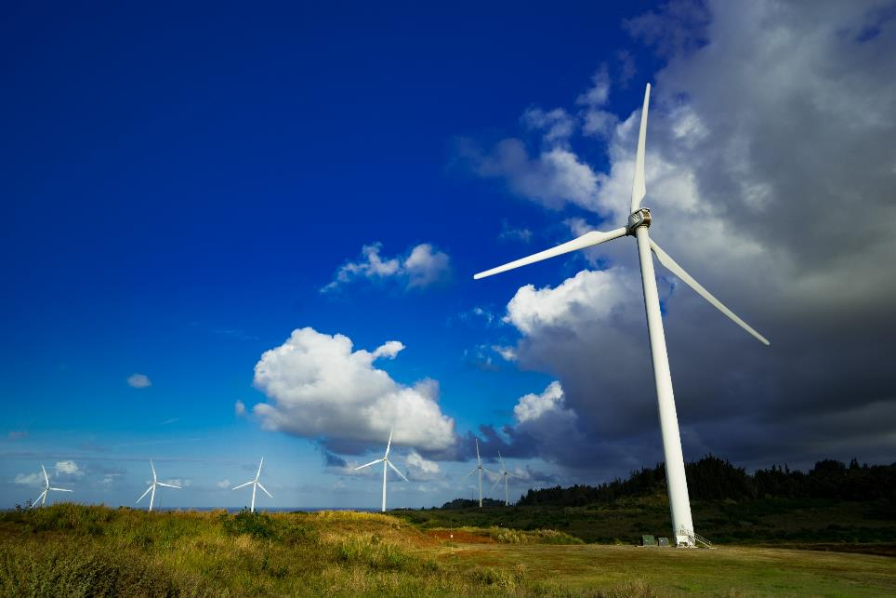
a

Slide 37
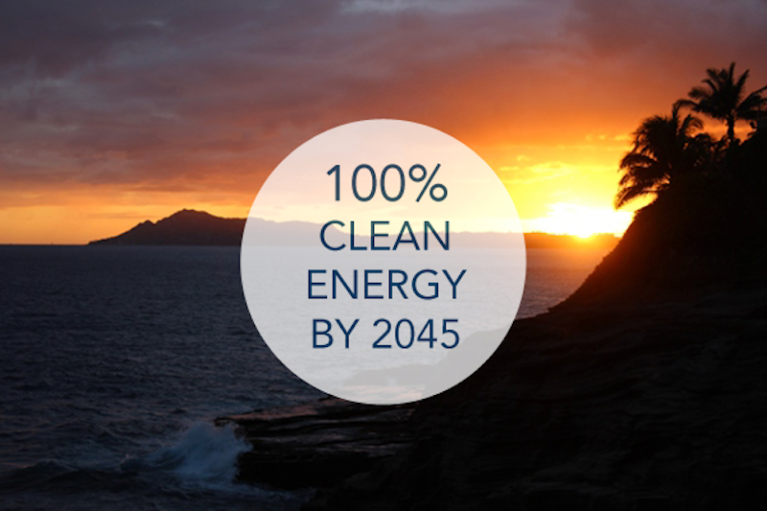

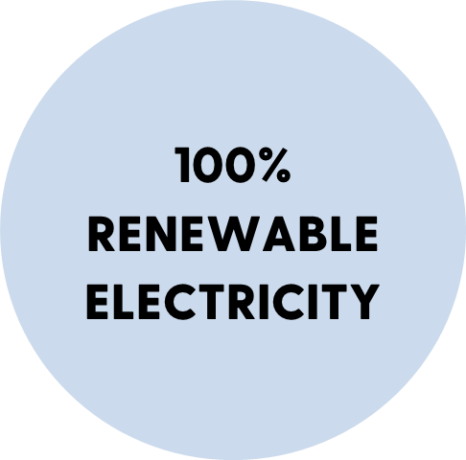
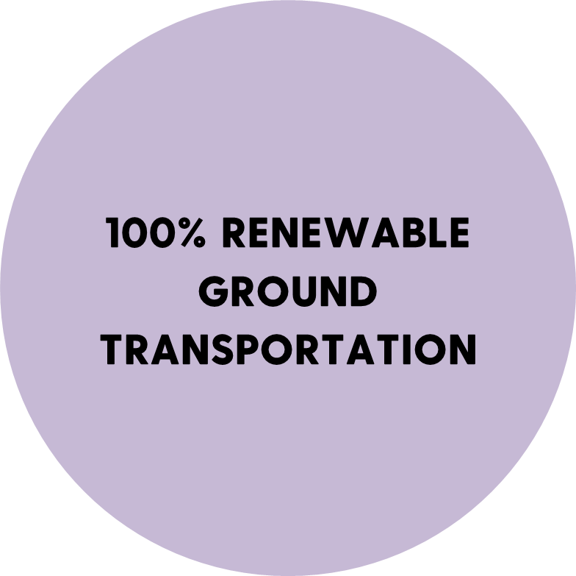


Slide 38

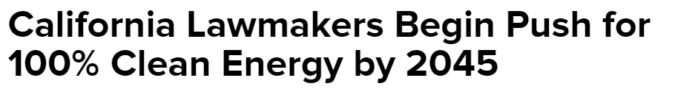
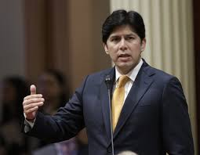


Slide 39
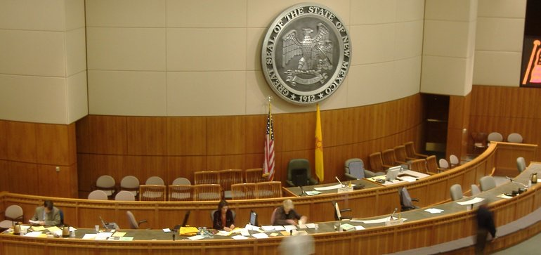
New Mexico Joins Hawaii & California
100% Carbon Free Energy by 2045

Slide 40
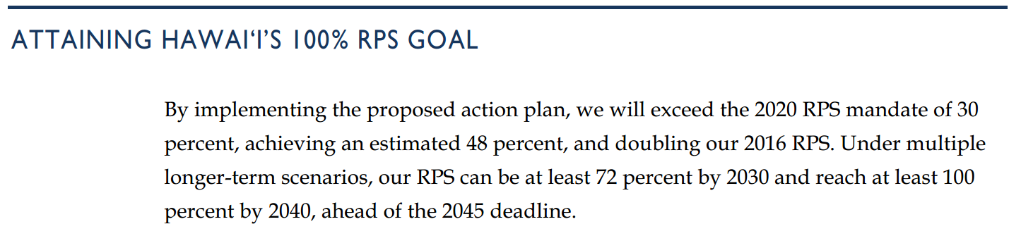

Slide 41
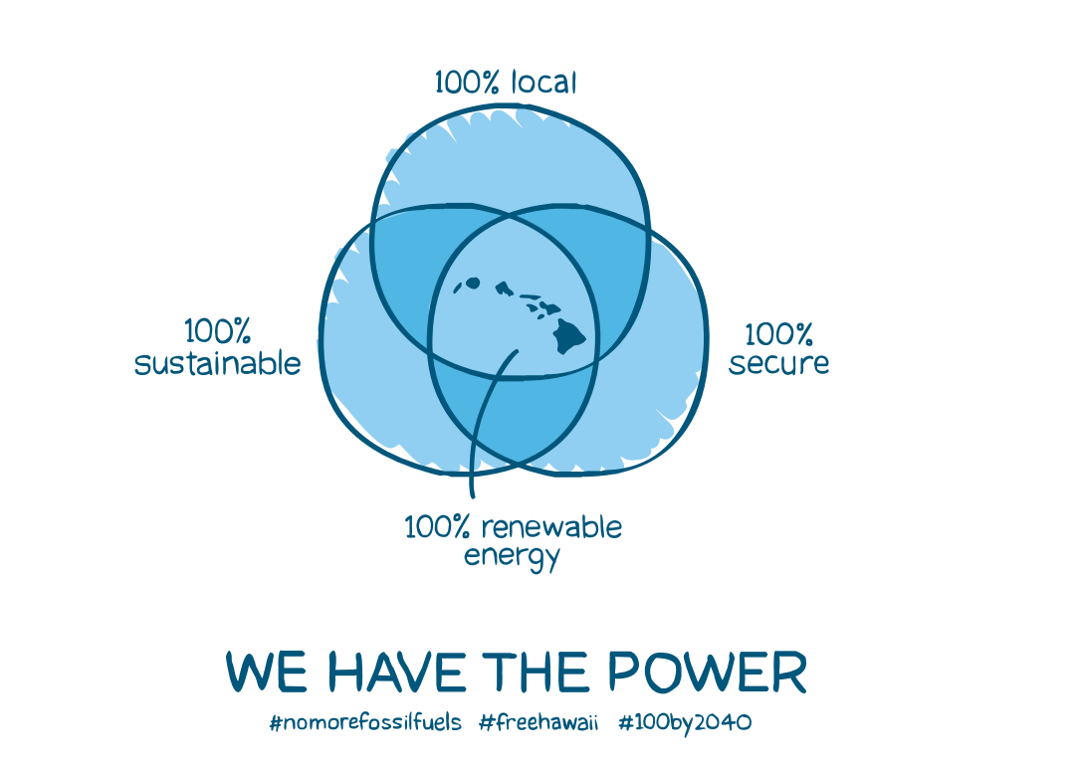

Slide 42



Slide 43
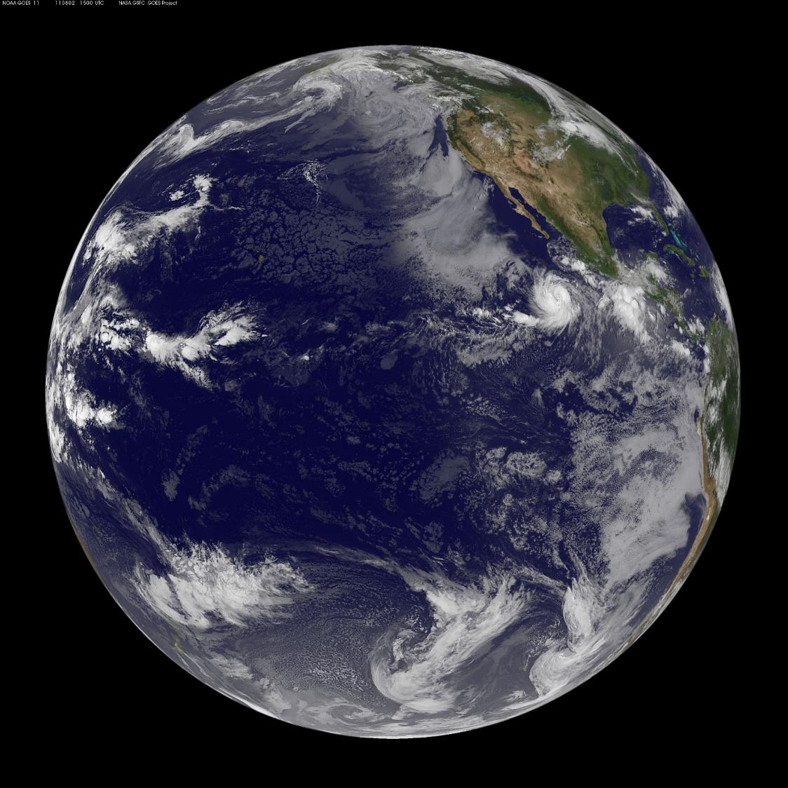
2019

