Slide 1
Black Marble: Mapping Recovery Through Satellite Data
Miguel O. Román, PhD
Founding Director, Earth from Space Institute (EfSI)
Universities Space Research Association (USRA)

Slide 2
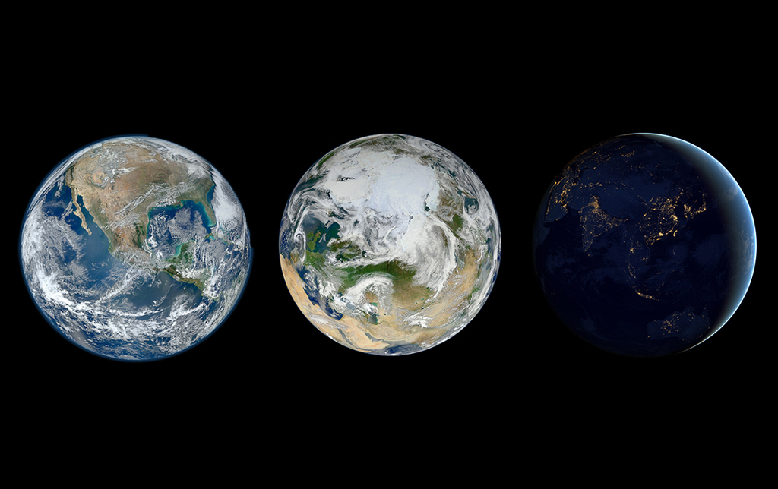

Slide 3
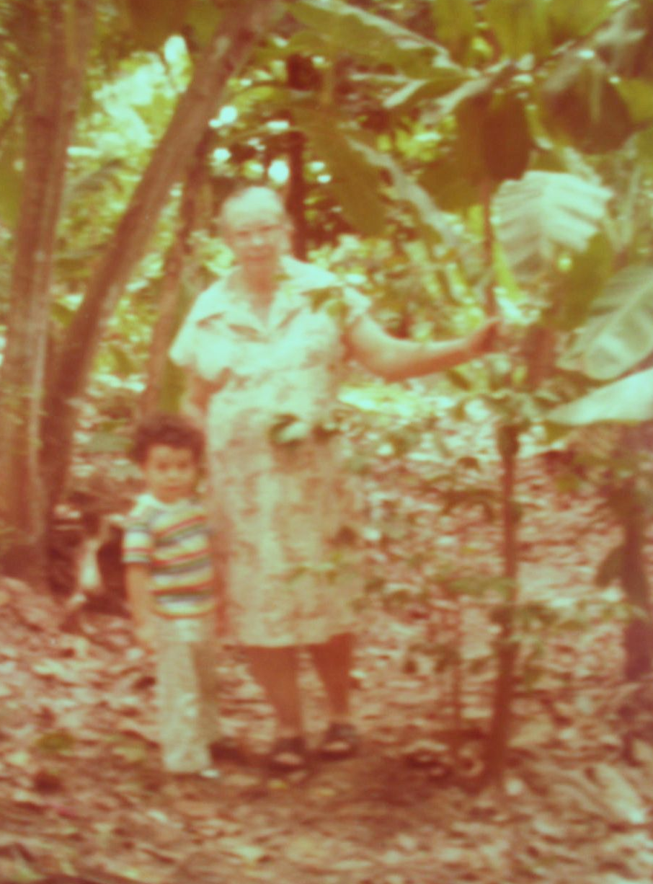
How does one become an
Earth System Scientist?

Slide 4
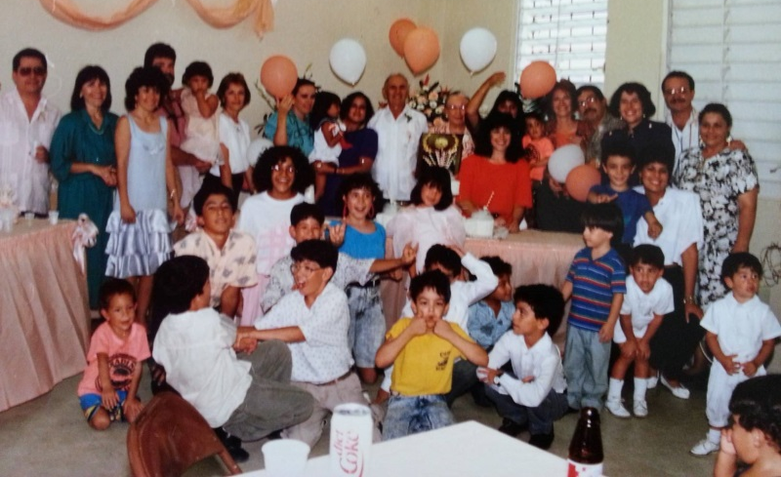
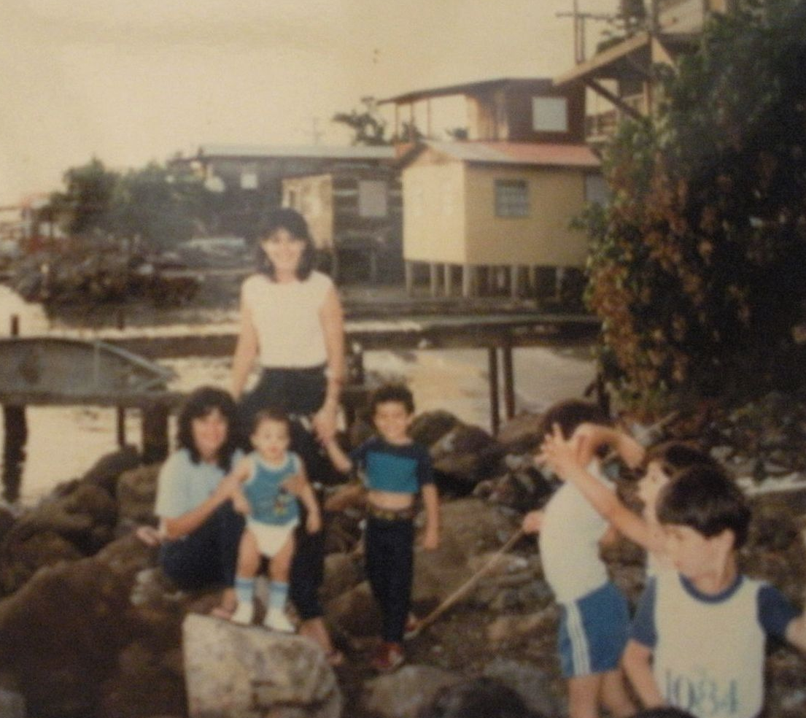
Familia Colón Ortíz: 50th Wedding Anniversary
La Parguera, Lajas

Slide 5
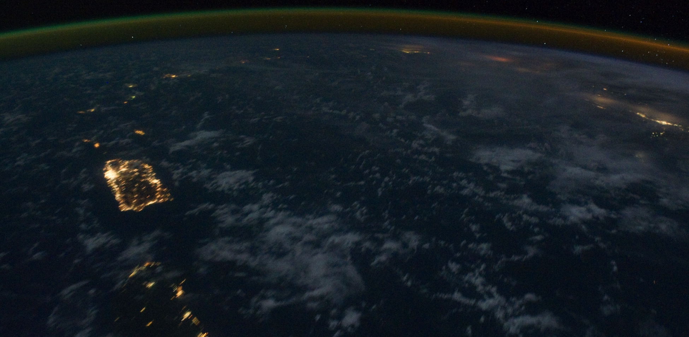
What makes a community meaningfully similar or different is not just its landscape, but also its people.

Slide 6
Notes:
What we have found is that, almost all the signal we get at night has to do with some form of human activity. We can study processes that we couldn’t before, processes related to energy, and the complex intersection between energy behaviors and climate change.
And we know that this is a powerful new tool for climate change research because,

Slide 7
Notes:
What we have found is that, almost all the signal we get at night has to do with some form of human activity. We can study processes that we couldn’t before, processes related to energy, and the complex intersection between energy behaviors and climate change.
And we know that this is a powerful new tool for climate change research because,

Slide 8
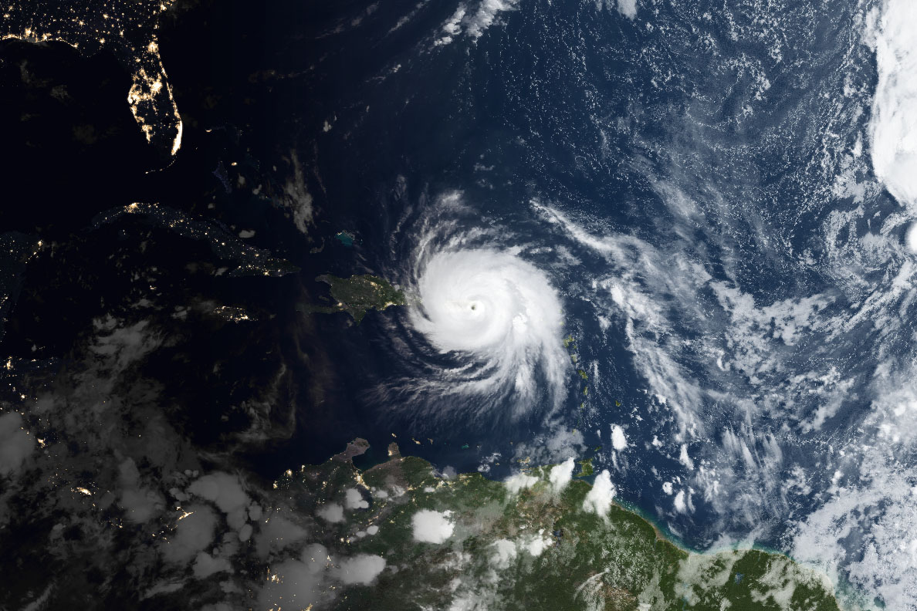
Puerto Rico at Night: Disaster Response and Recovery after Hurricane Maria

Slide 13
The Black Marble Alliance: Why us? Why now?

Slide 14
Thank you! ¡Muchas Gracias!
For More Info:
www.usra.edu
mroman@usra.edu
@USRA_Roman

