Slide 1
John Farrell
Director
Energy Democracy Initiative of the Institute for Local Self-Reliance

Slide 2
End of federal manufacturing tax incentives starts 10-year economic downturn
PROMESA applies highest state sales tax in nation (11.5%) to repay hedge fund creditors
Last federally appointed governor gives free electricity to municipalities; costing each customer $123 in 2016
“Semi-colonial” PROMESA board strips local financial control
Today
1940
1940s
2005
2016
2019
2019
☹️ COLONIALISM

Slide 3
Accountability?
☹️ PRIVATIZATION

Slide 4
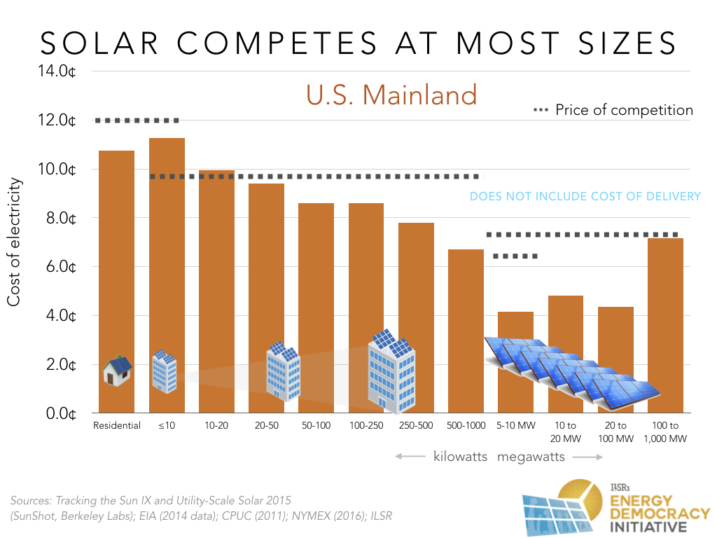
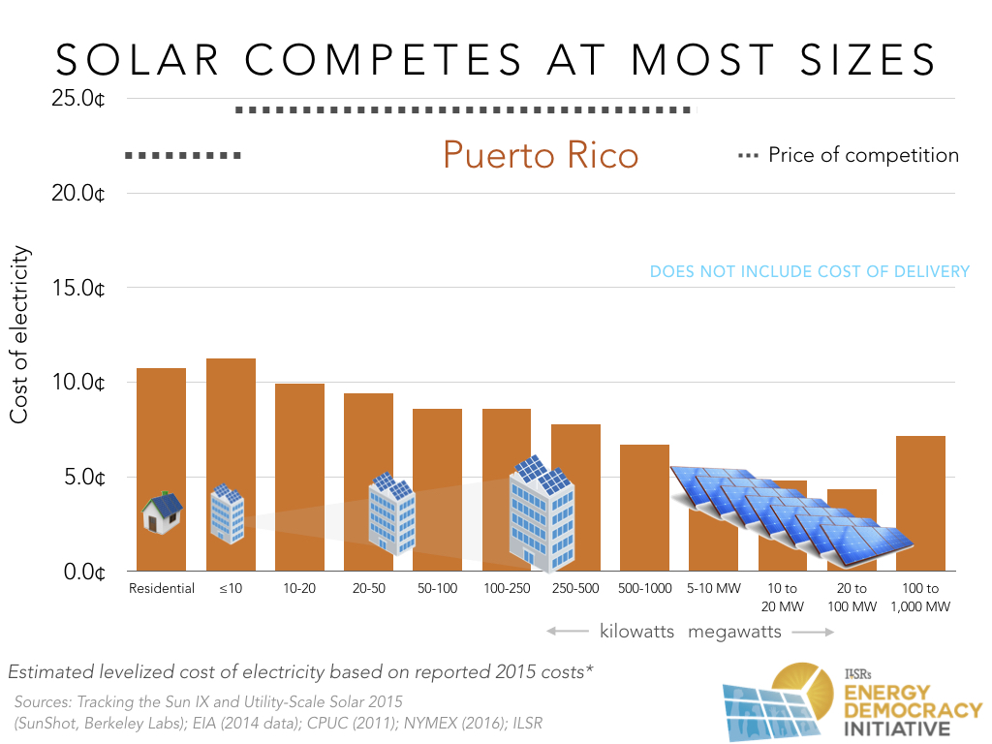
😄 SCALE

Slide 5
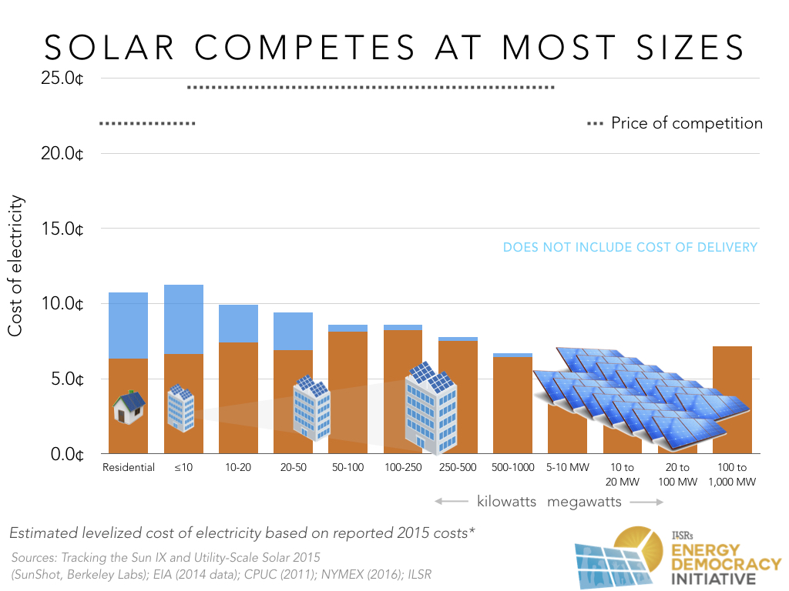
😄 SCALE

Slide 6
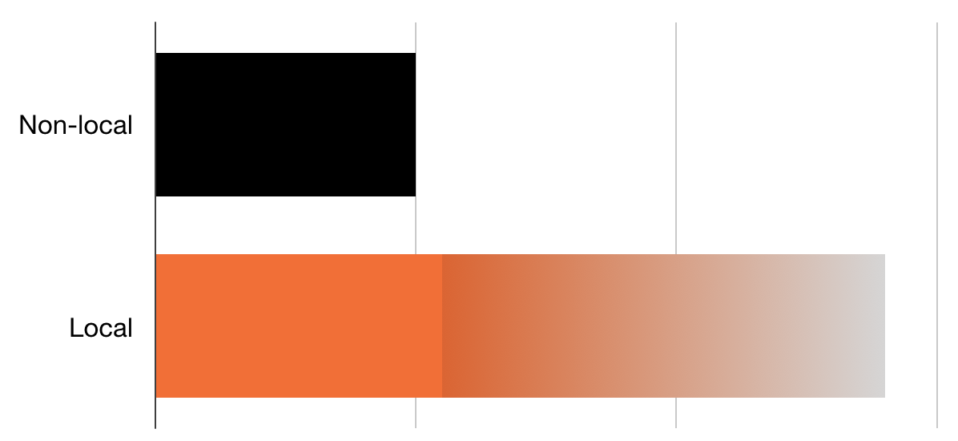
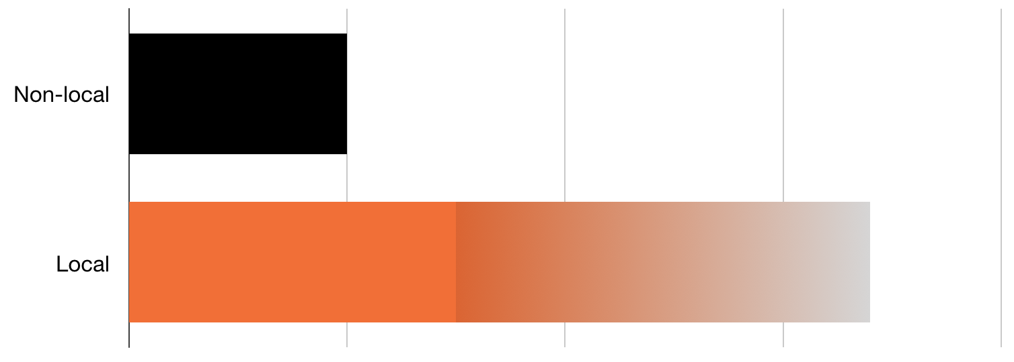
Community Ownership Increases Local Benefits
Jobs by Project Ownership
Economic Impact by Project Ownership
😄 OWNERSHIP

Slide 7
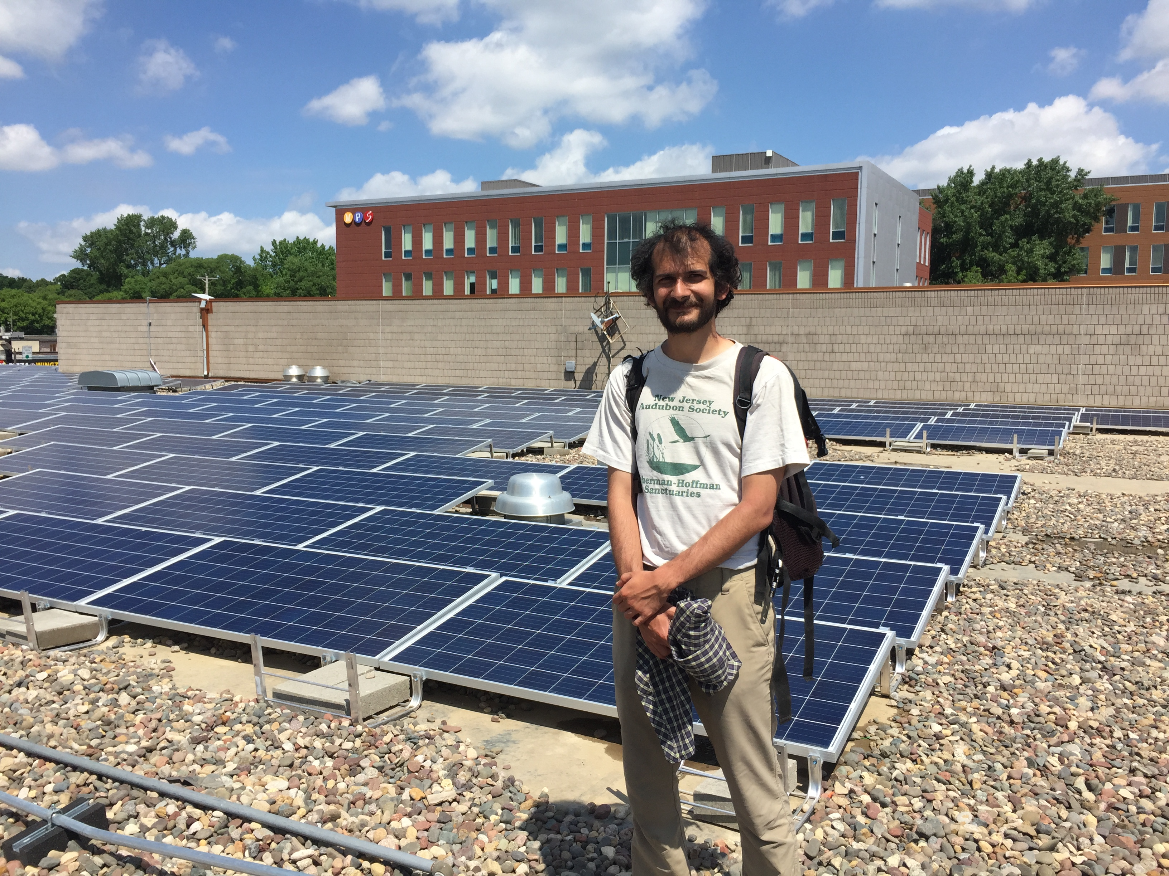
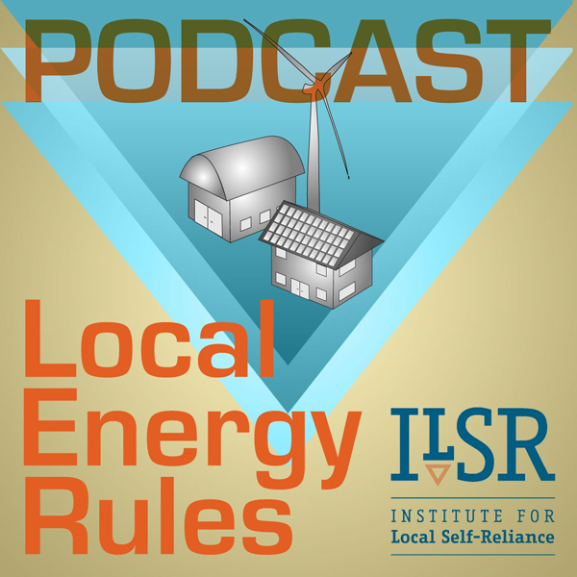
Community Ownership Increases Local Benefits
😄 OWNERSHIP

Slide 8
The rules must allow communities to choose
www.ilsr.org

