Slide 1
Roy Torbert
Principal, Islands Energy Program
Rocky Mountain Institute

Slide 2
Power Sector Context:
Diverging economic outcomes
Energy sector holding back growth and vulnerable to extreme weather
Opportunity:
New role for policy and regulation
Community-led system reinvention, catalyzed by new technology
Potentially profitable investments in the energy sector

Slide 3
Resilience:
New energy systems (solar, battery, wind, etc.) can be more resilient, but are not necessarily.
Proper design practices are required, as well as a thoughtful approach for the grid architecture, to include utility long-term planning

Slide 4
Value of New Technology
- Both energy efficiency and battery storage are flexible resources that can lower costs and improve system resilience, through:
Decreasing backup generation needs and up-front capital costs
Reducing dependence on outside fuel sources
Decreasing life-cycle costs and increasing value
Generating revenue and supporting the grid of the future
Meeting related objectives (cost, carbon, etc.)

Slide 5
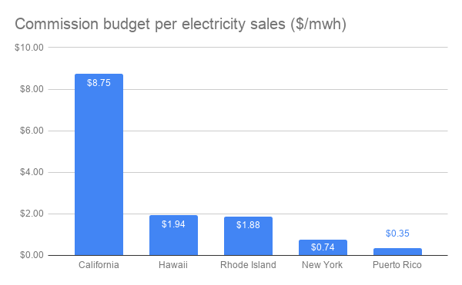
Immediate Priorities:
Set clear vision and principles, both through policy and utility planning
Support the regulator
Expedite projects to benefit the grid and customers

Slide 6
Thank you
Notes:
Images courtesy of NECN and CNBC

